Slide 1
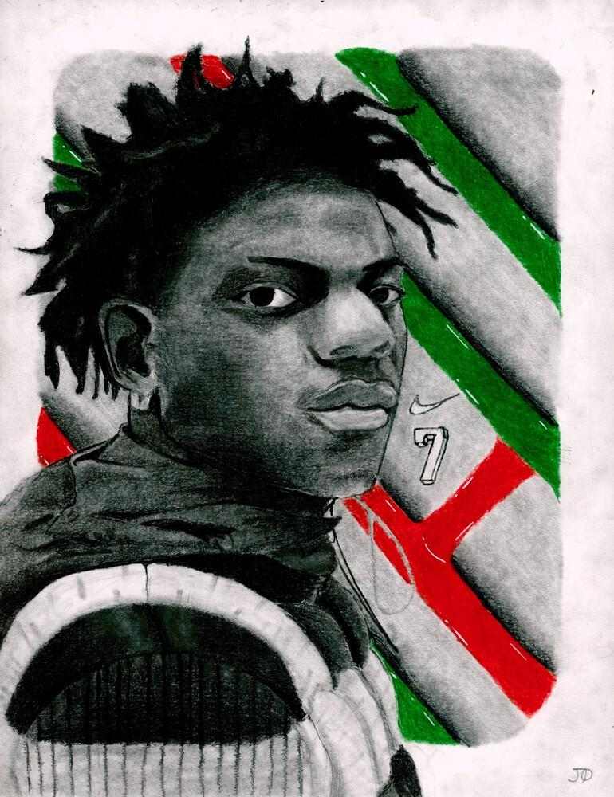
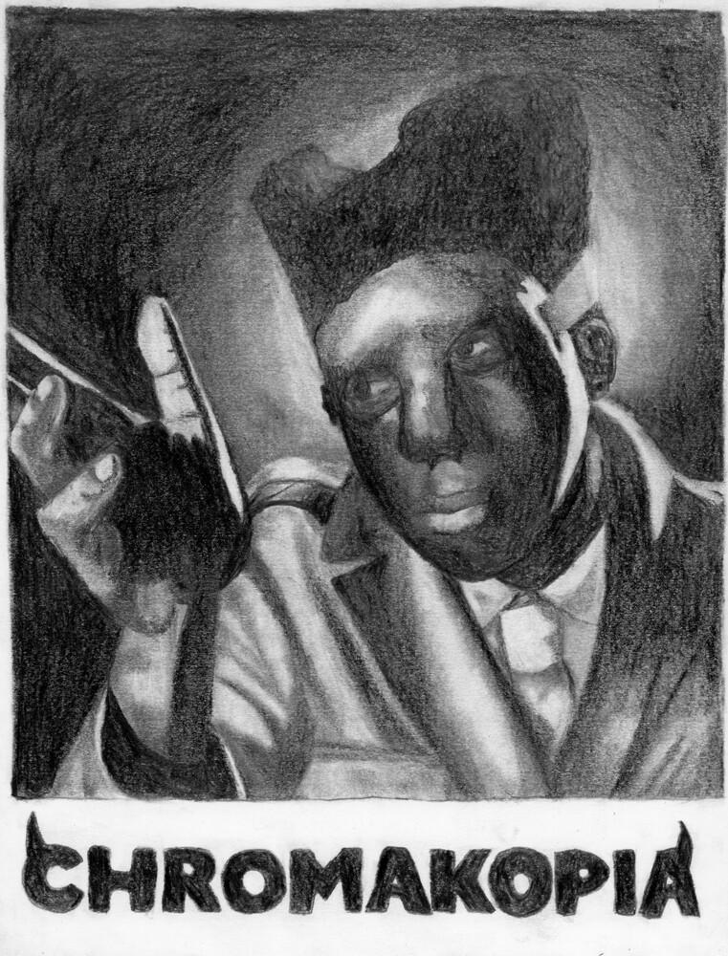
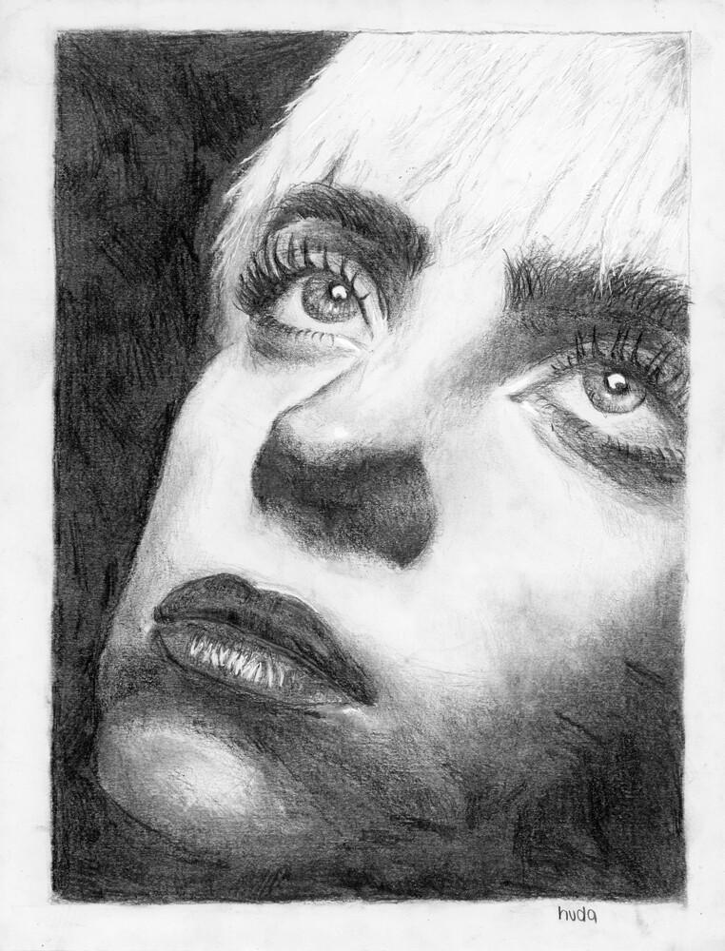
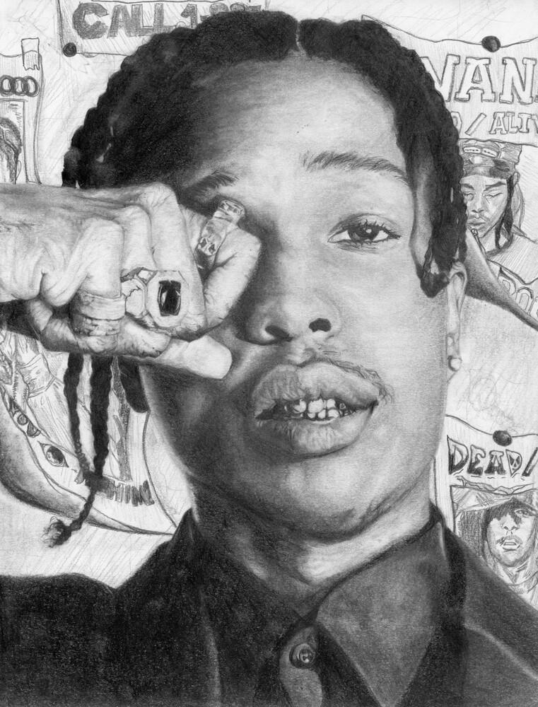
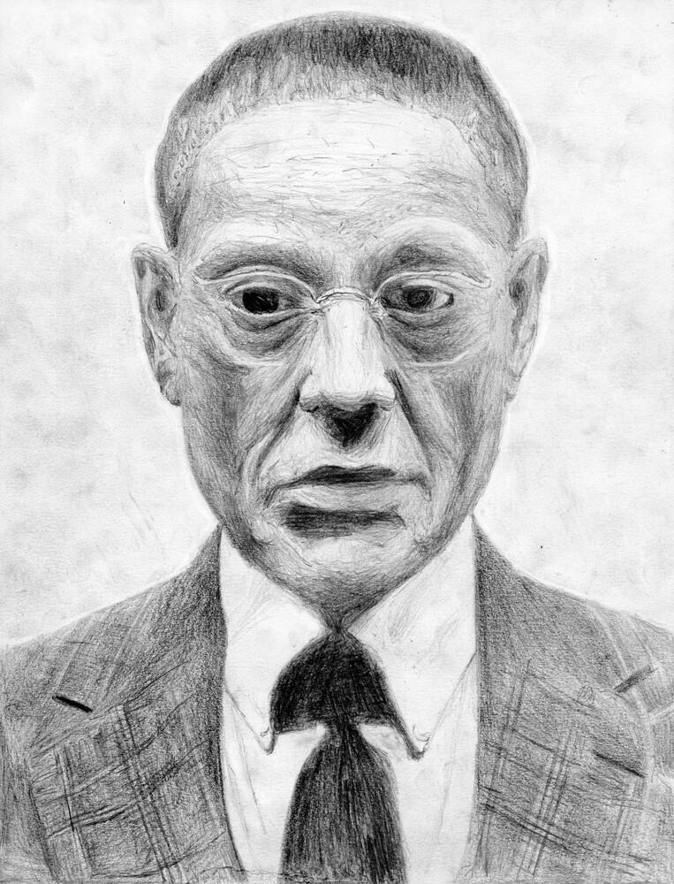
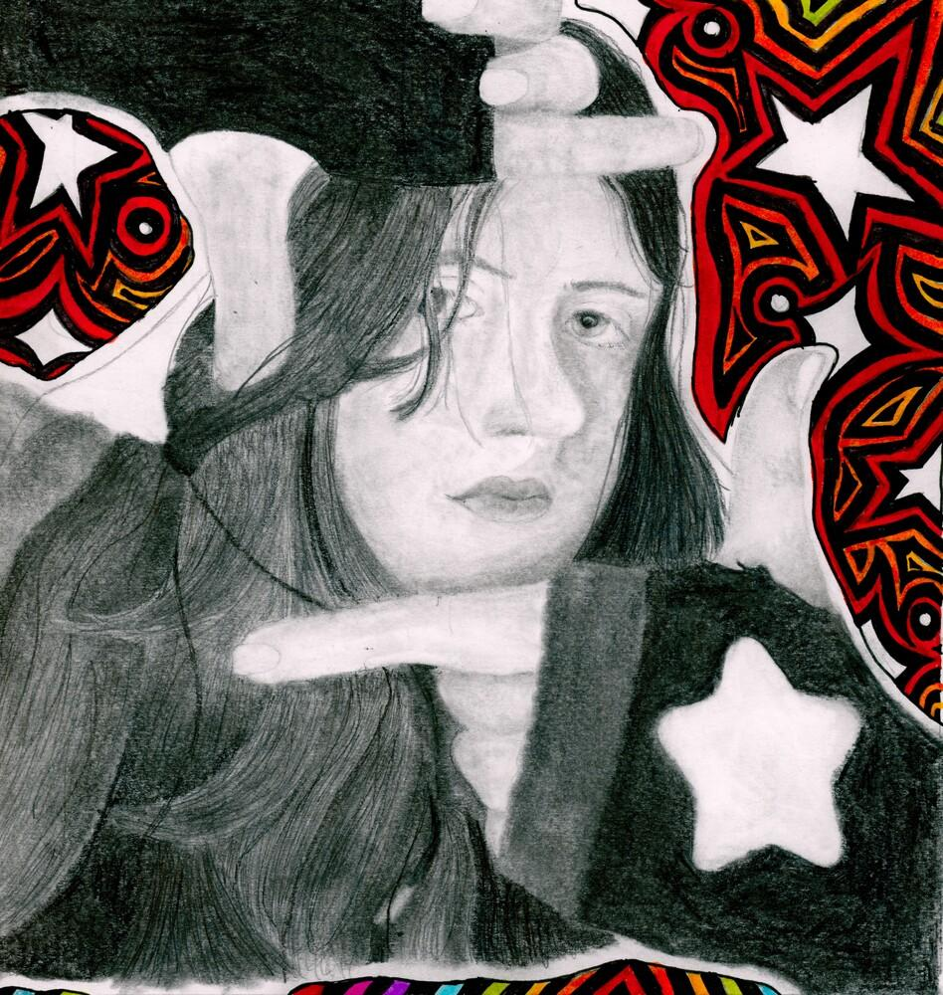
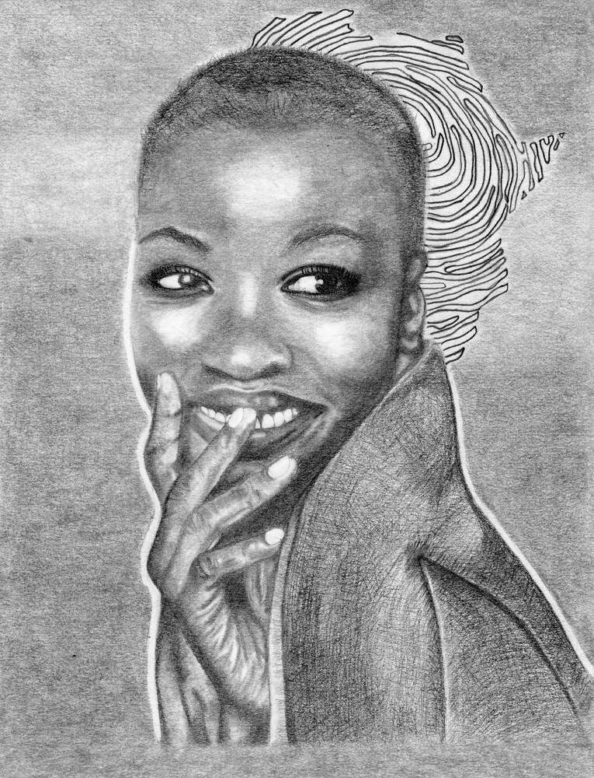
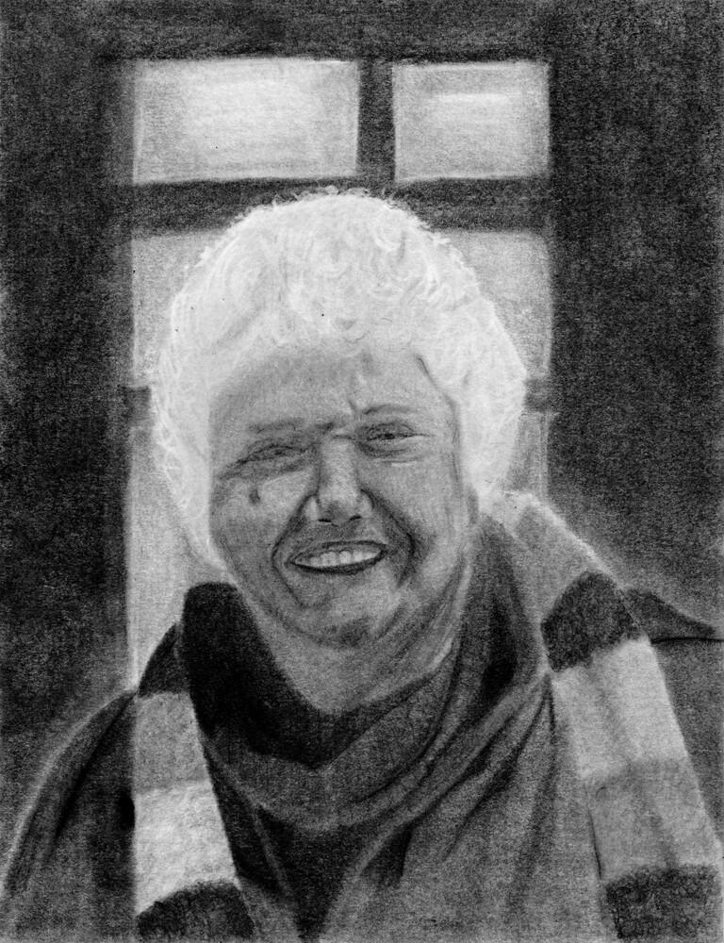
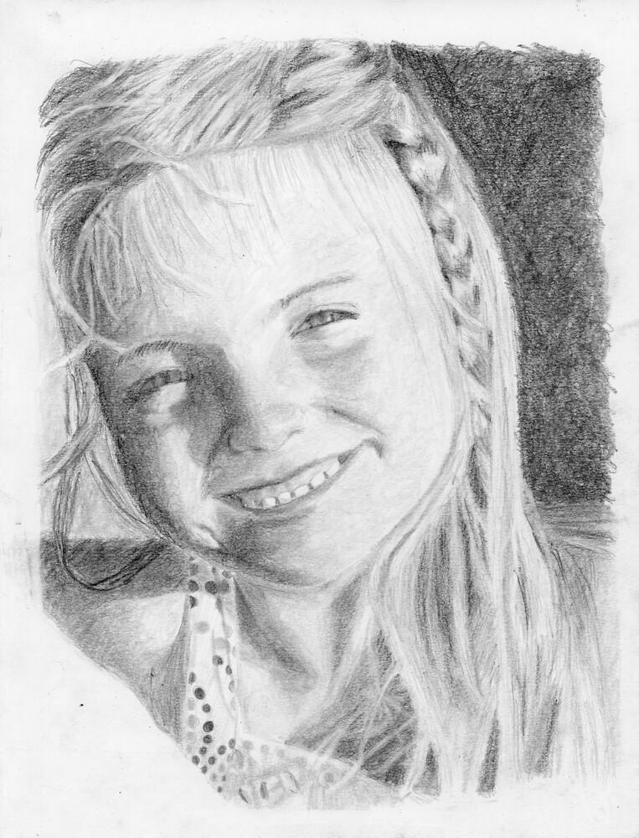
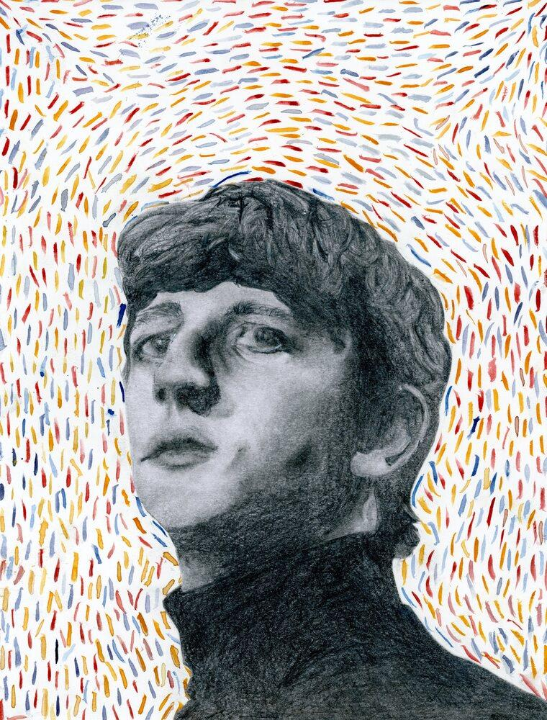
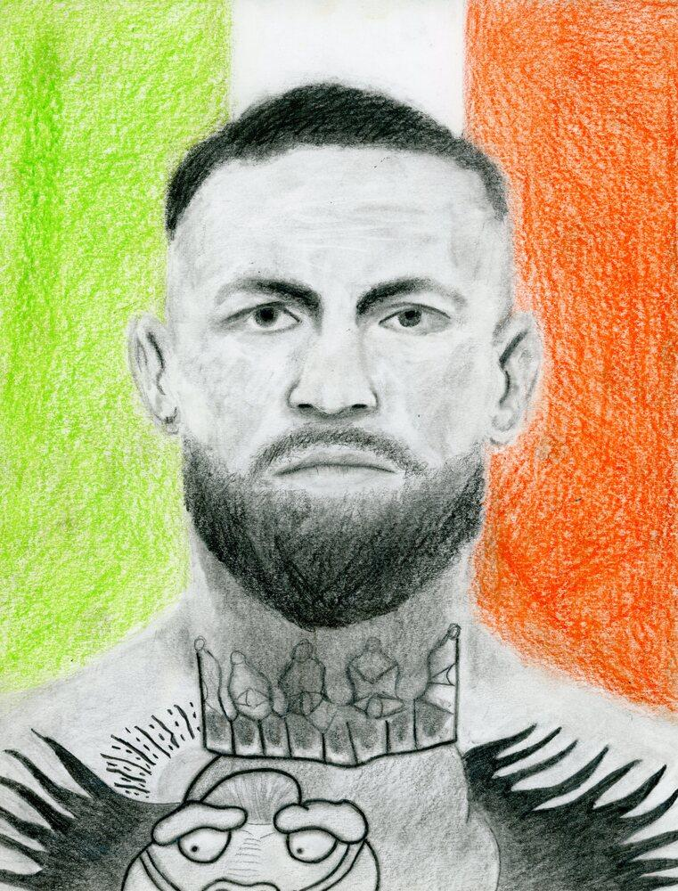
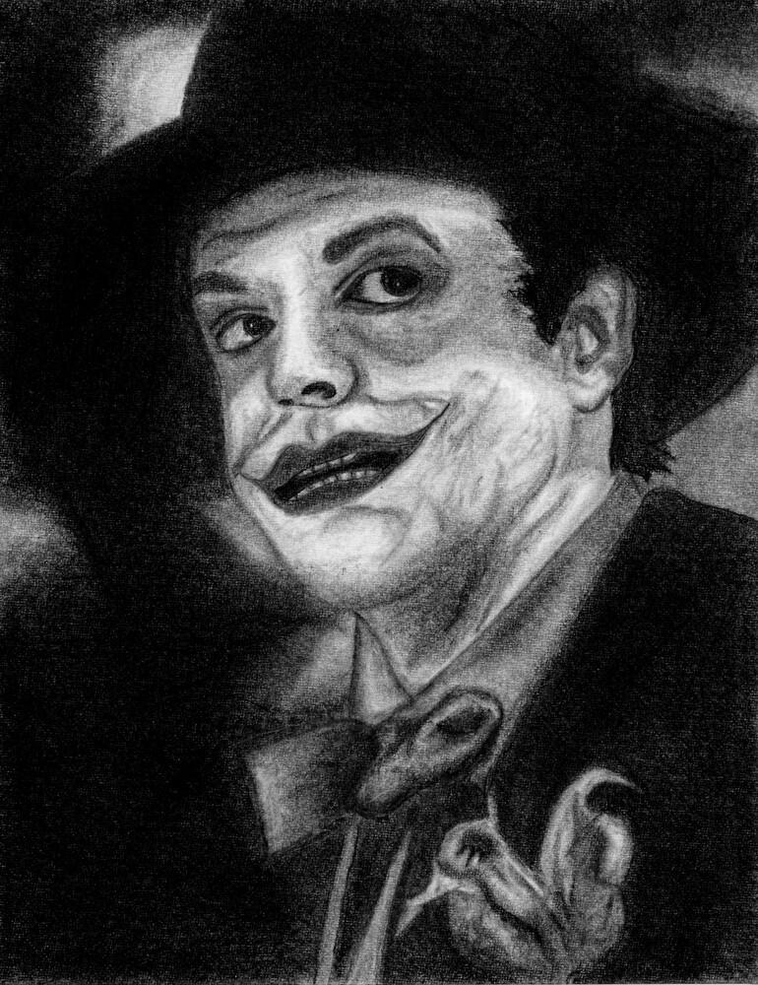
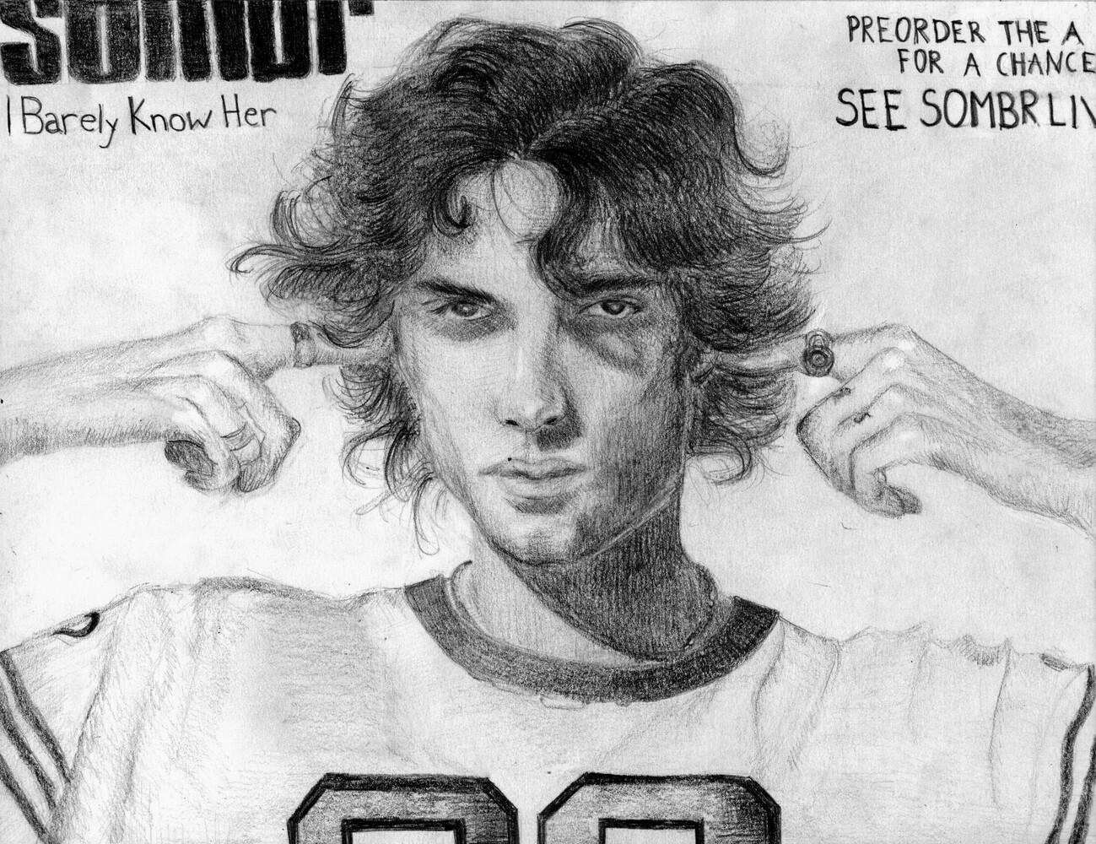
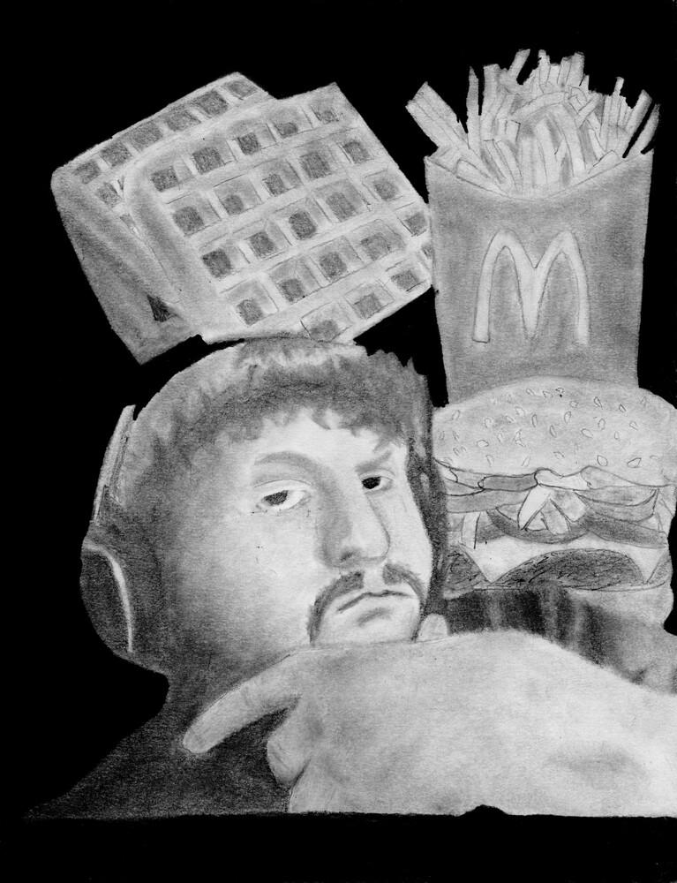
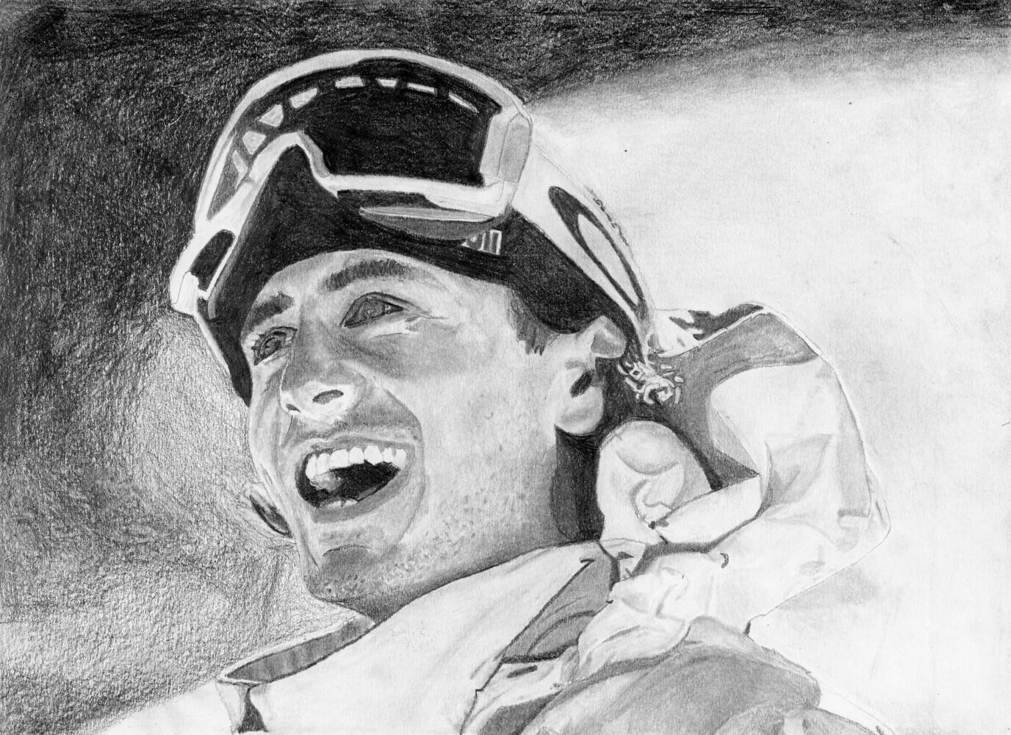
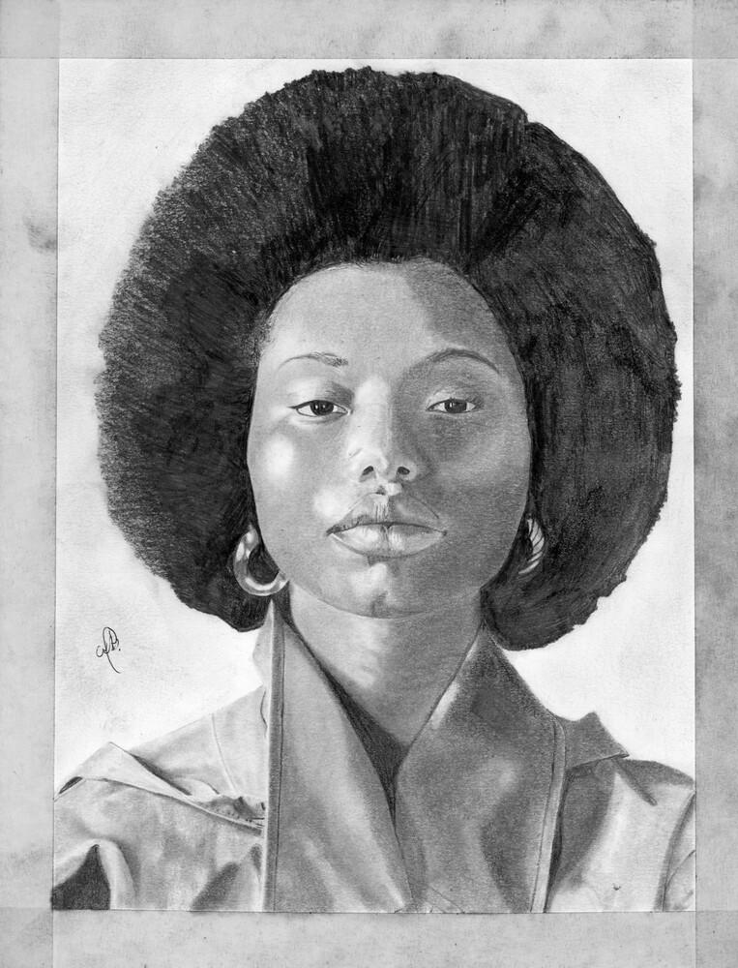
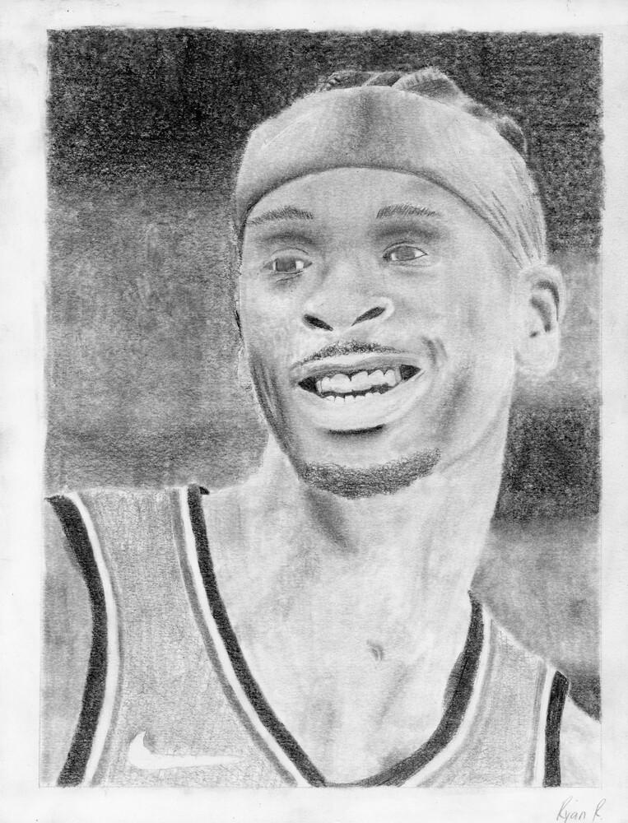
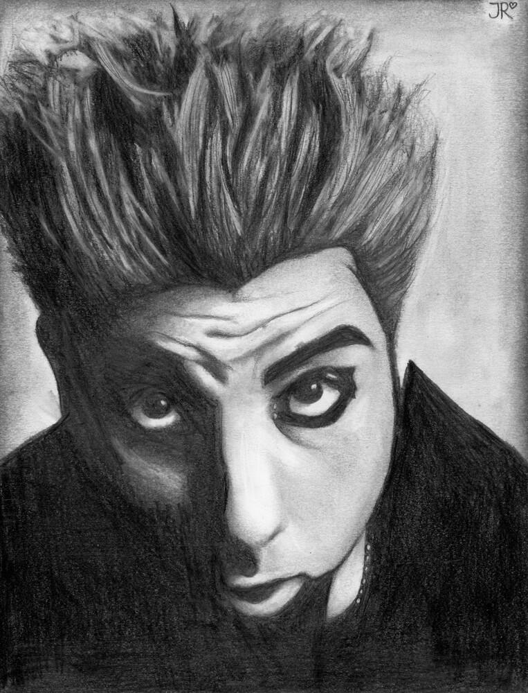
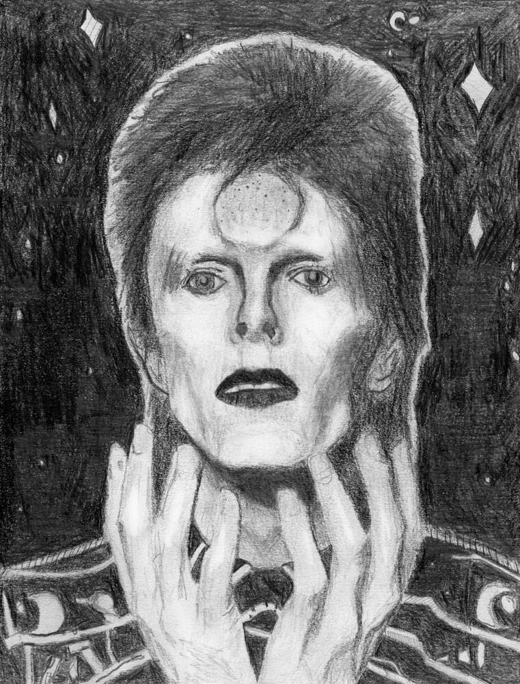
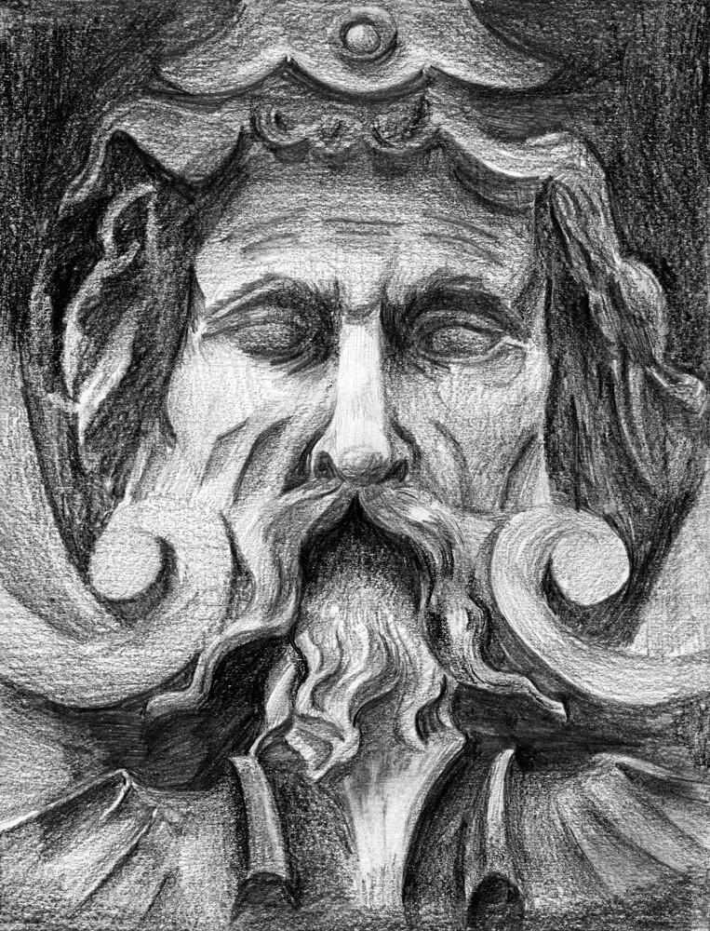
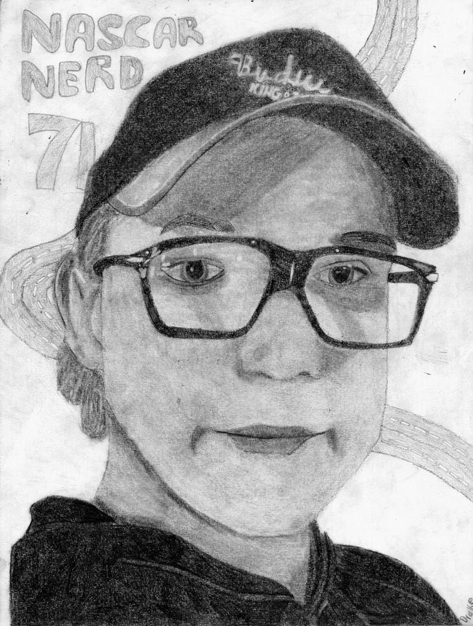
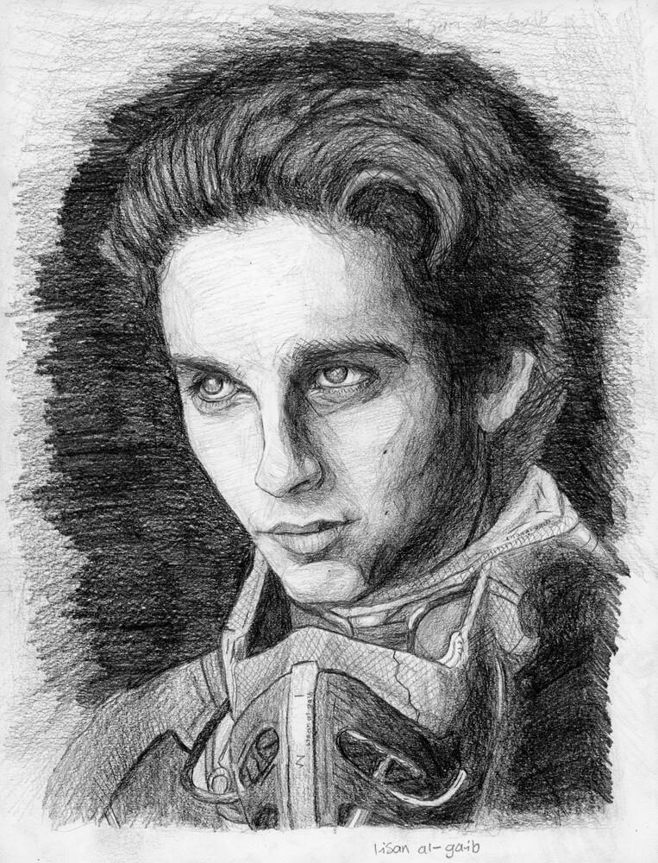
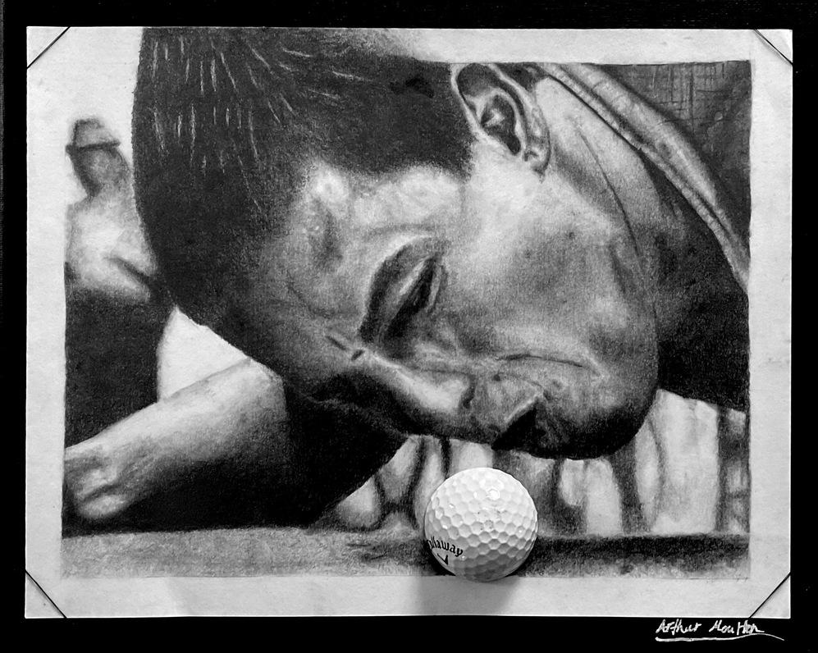
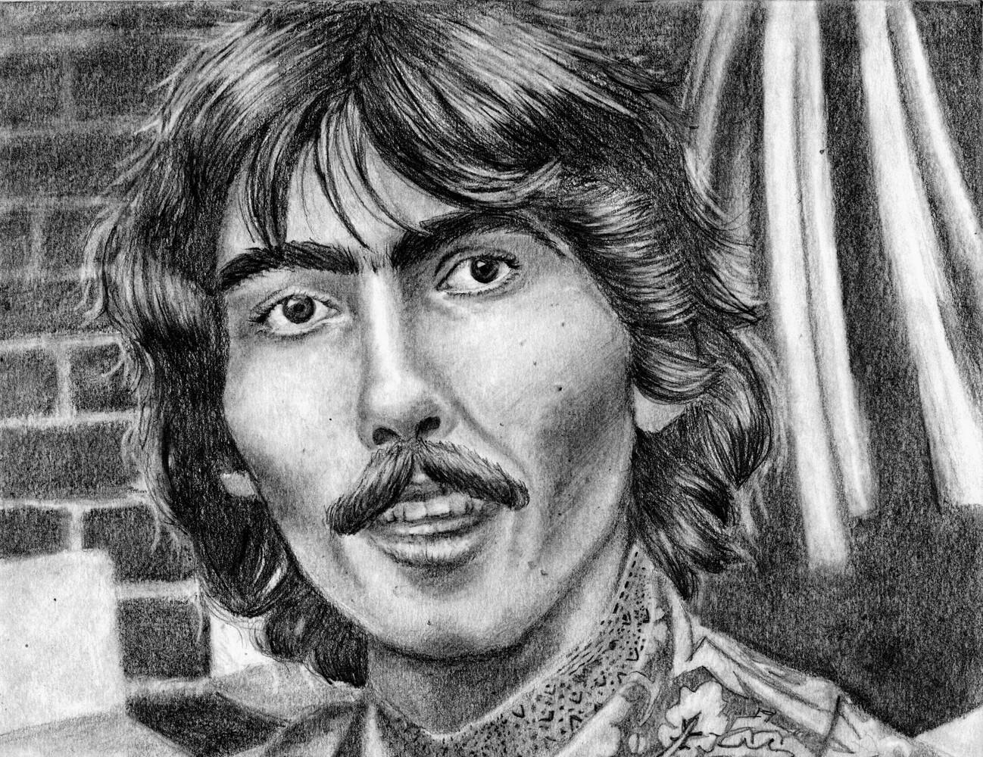
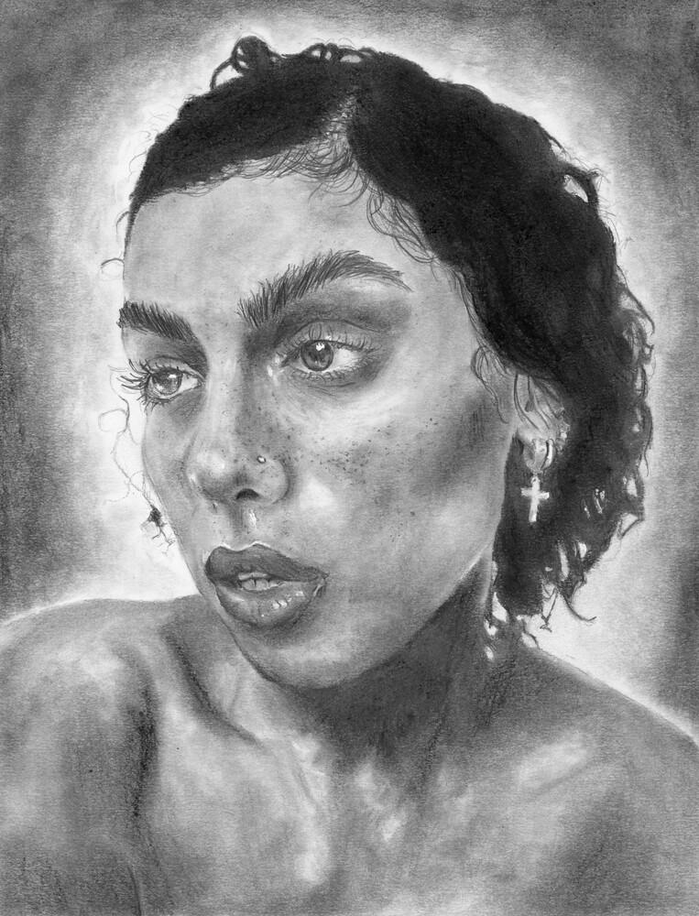
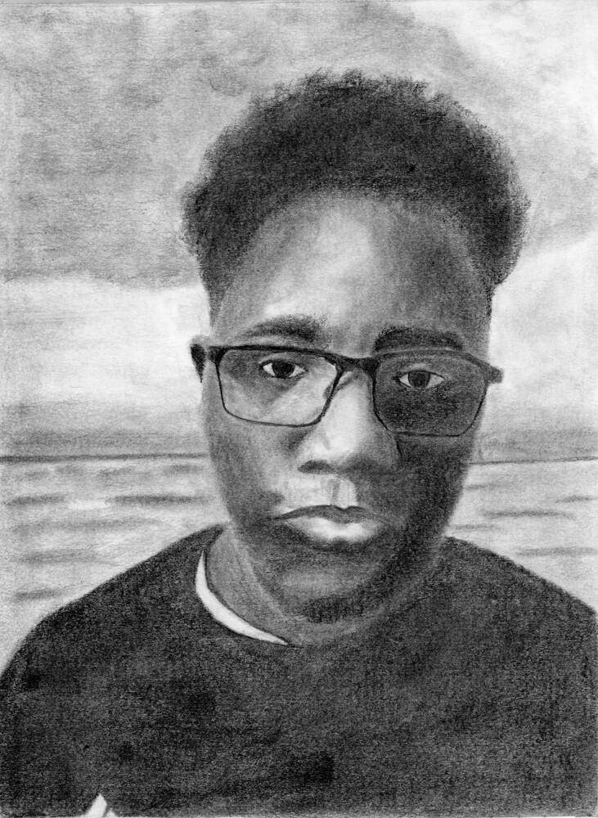
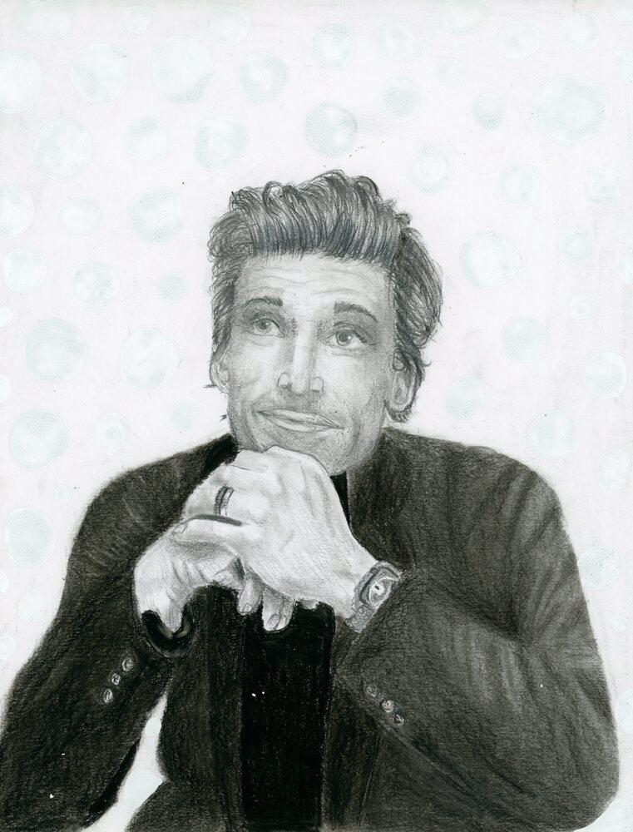
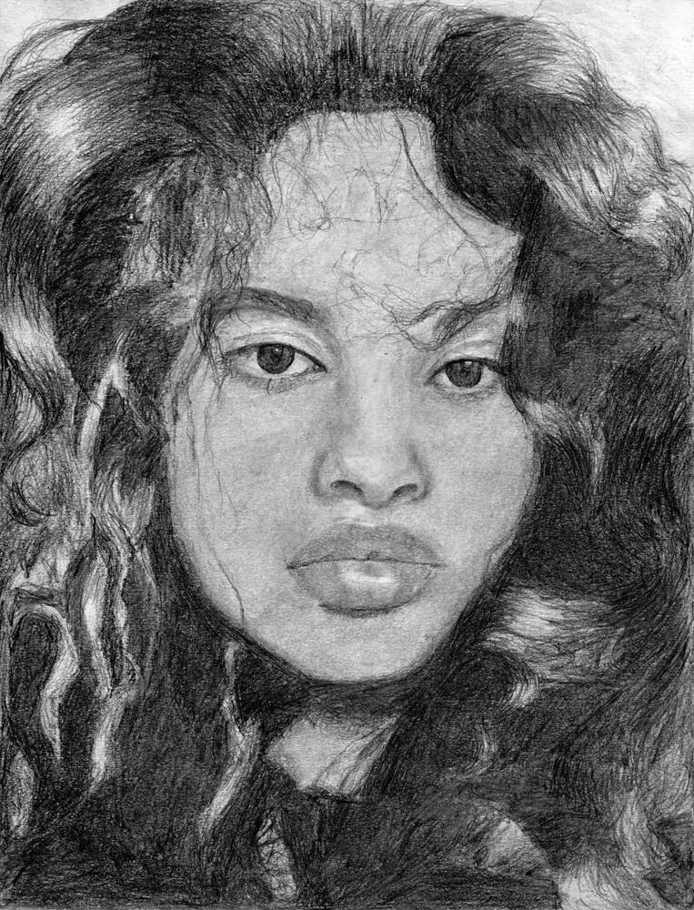
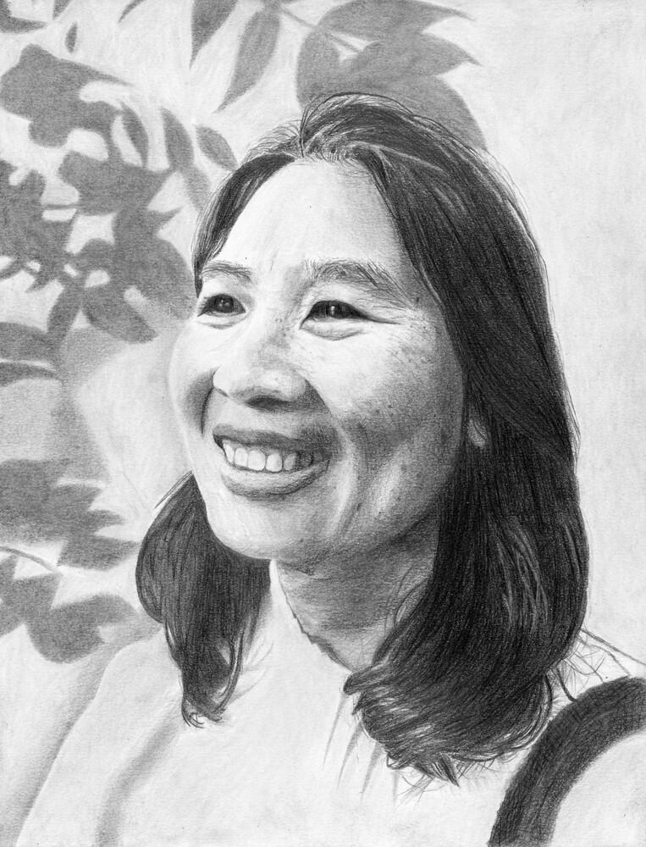
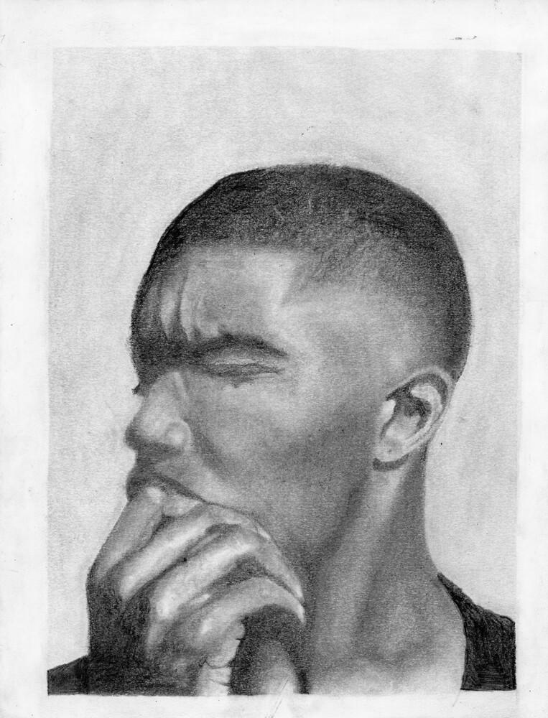
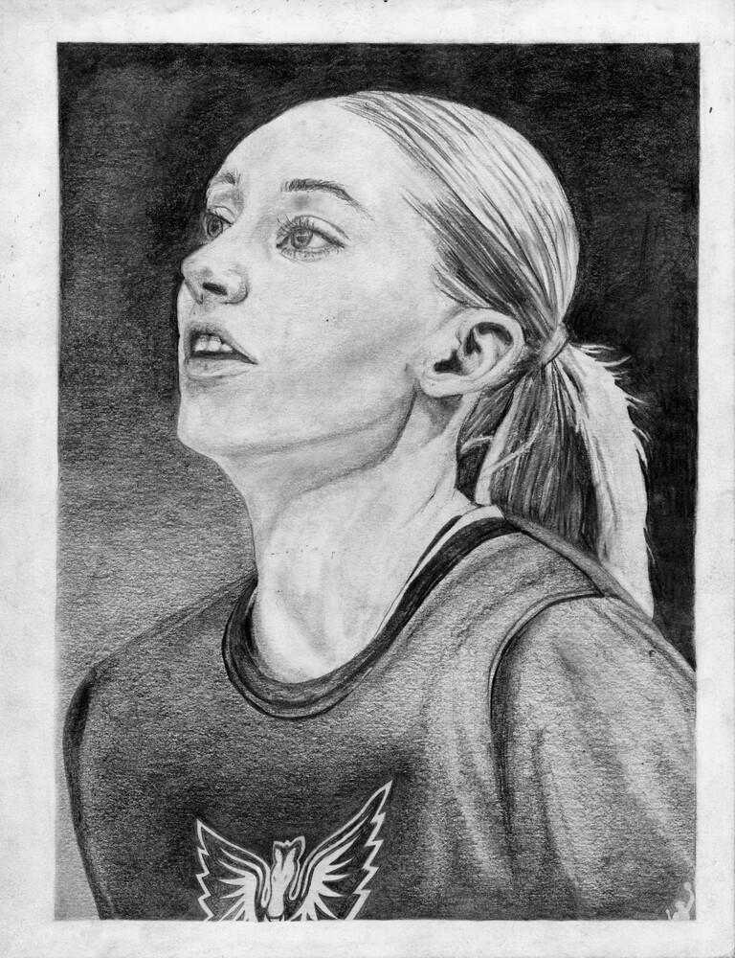
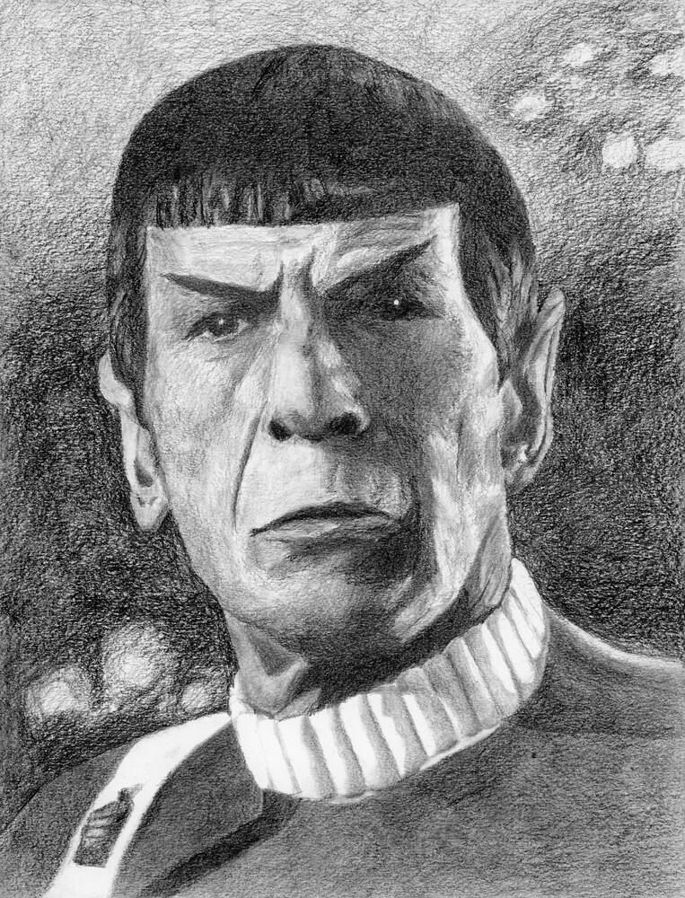
Cohen Demers, Fall 2025
Huda Elkord, Fall 2025
Justine Parreno, Fall 2025
Lochie Forde, Fall 2025
Kateryna Bilash, Fall 2025
Oliver Rutherford, Fall 2025
Matthew Mackey, Fall 2025
Covenant Bassey, Fall 2025
Ryan Rice, Fall 2025
Chloe Willett, Fall 2025
Jurni Robinson, Fall 2025
Arthur Moulton, Fall 2025
Portrait
________ Hand drawing (contour)
________ Stravinsky (contour)
________ The Woodcutter (shading)
________ Pears (blending)
________ Parts of the face
________ Hair textures
_____/10 Progress & goals
Advait Abhilash, Fall 2025
Matina Kyriakakos, Fall 2025
Jaiyla Slaunwhite, Fall 2025
Criteria for your finished Portrait:
Technique: Proportion & detail
Accurate shapes, sizes, and contour
Technique: Shading
Deep blacks, smooth, and well blended
Composition
Complete, full, finished, and balanced
Upshaw, Fall 2024

Slide 2





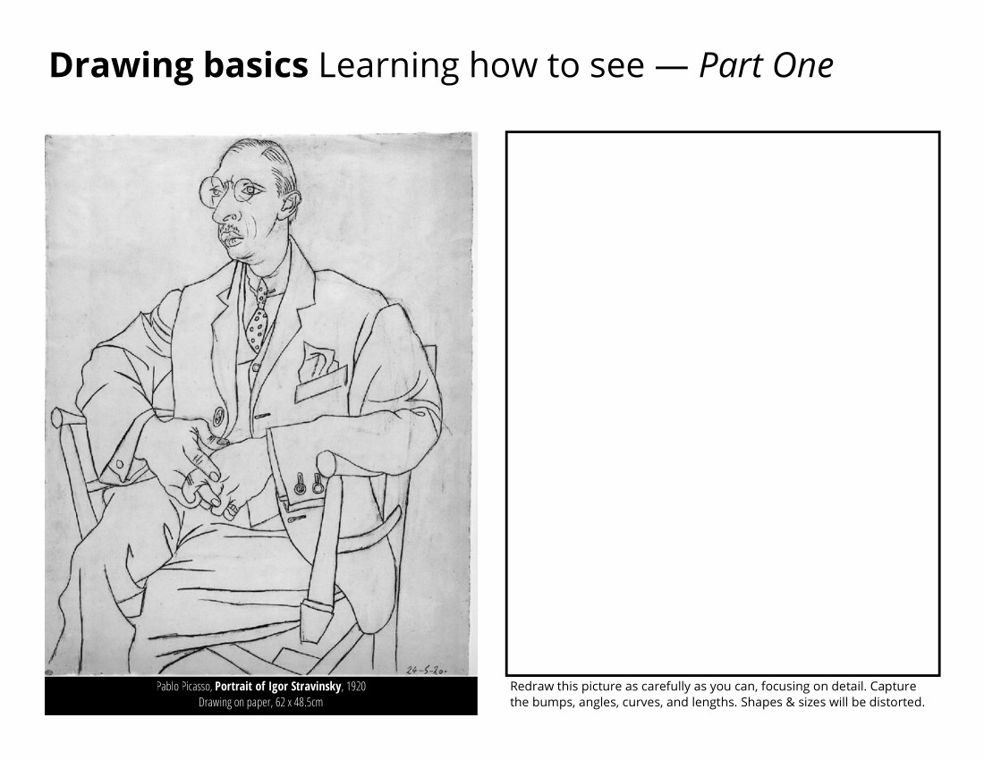
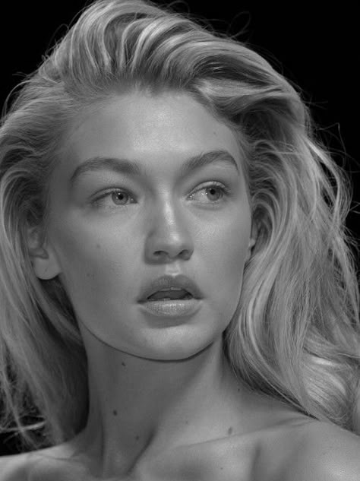
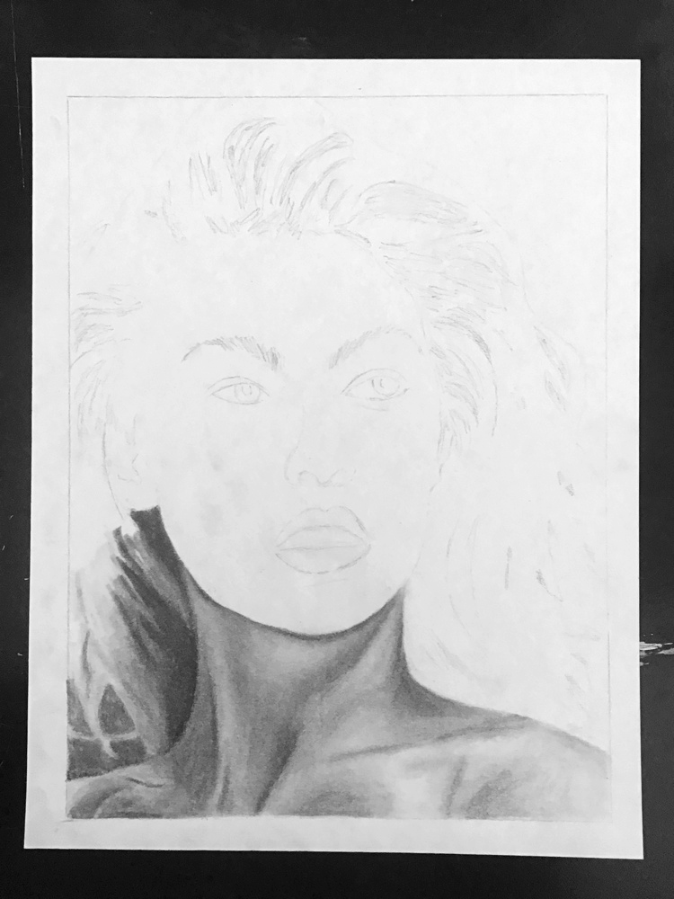
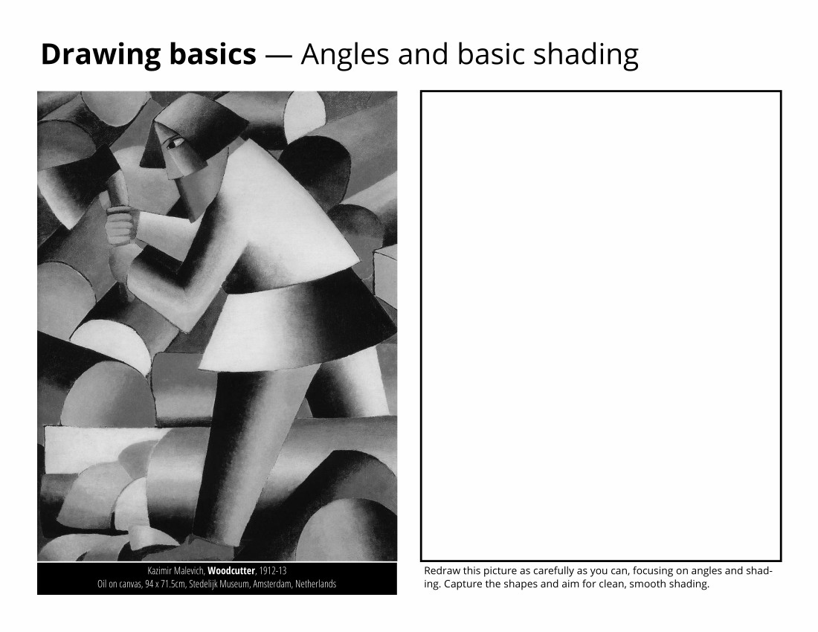

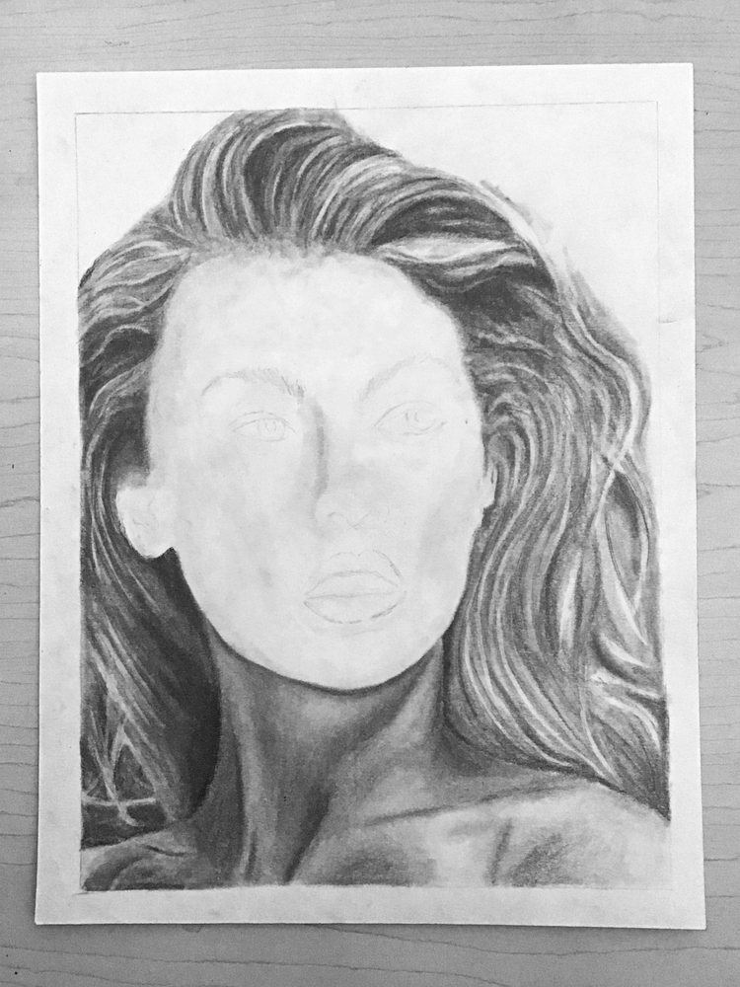
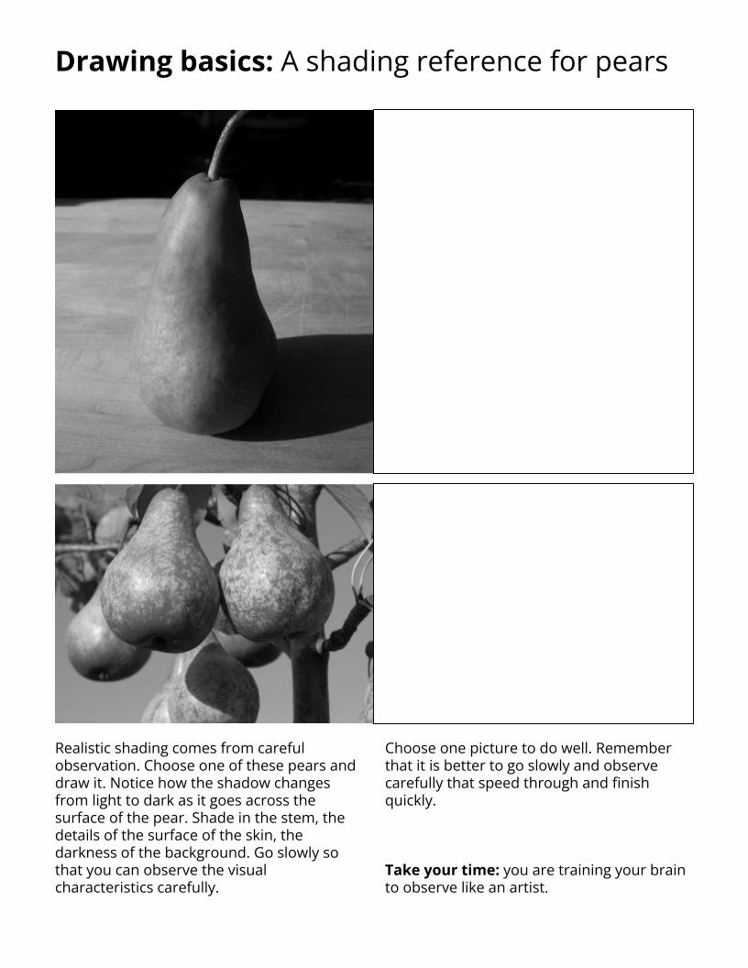
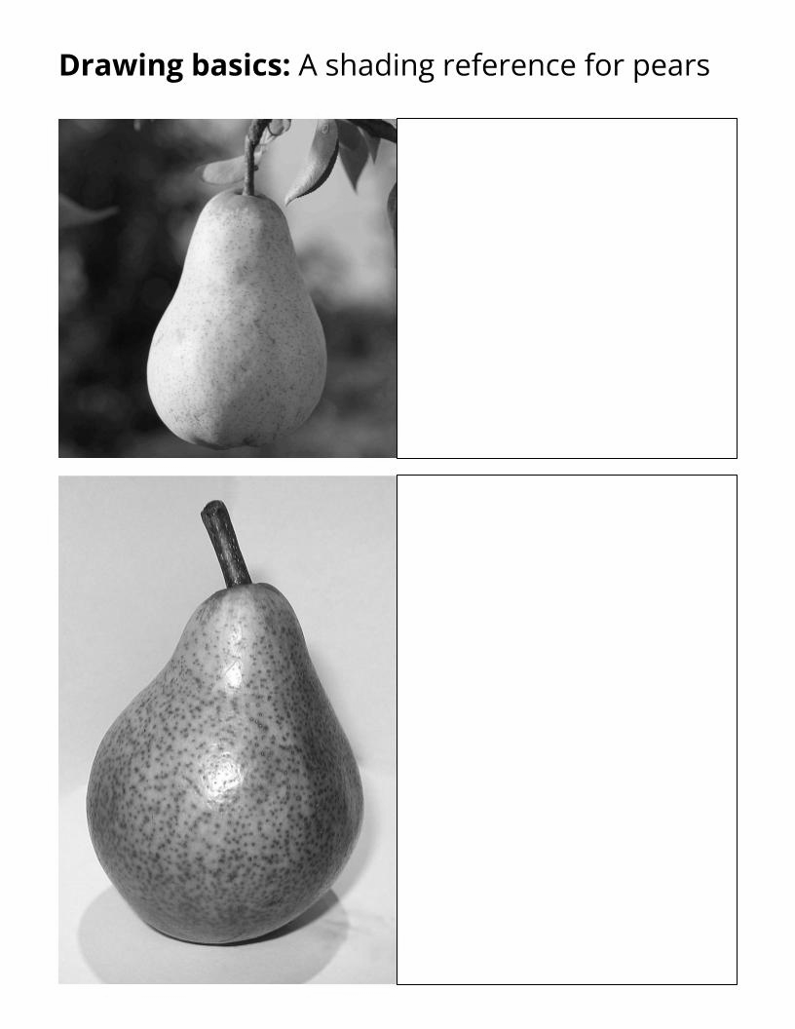
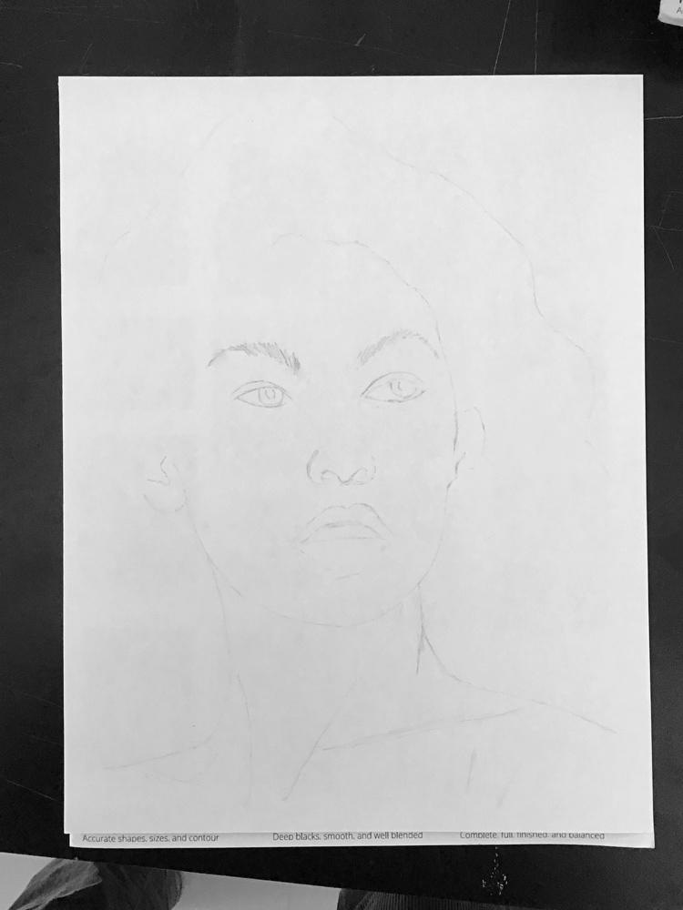
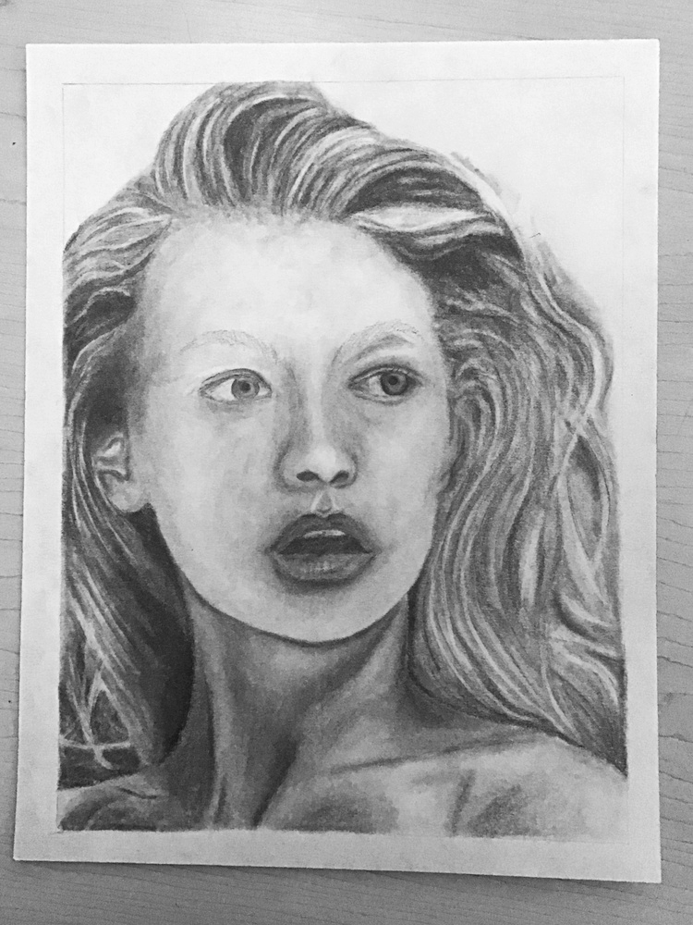



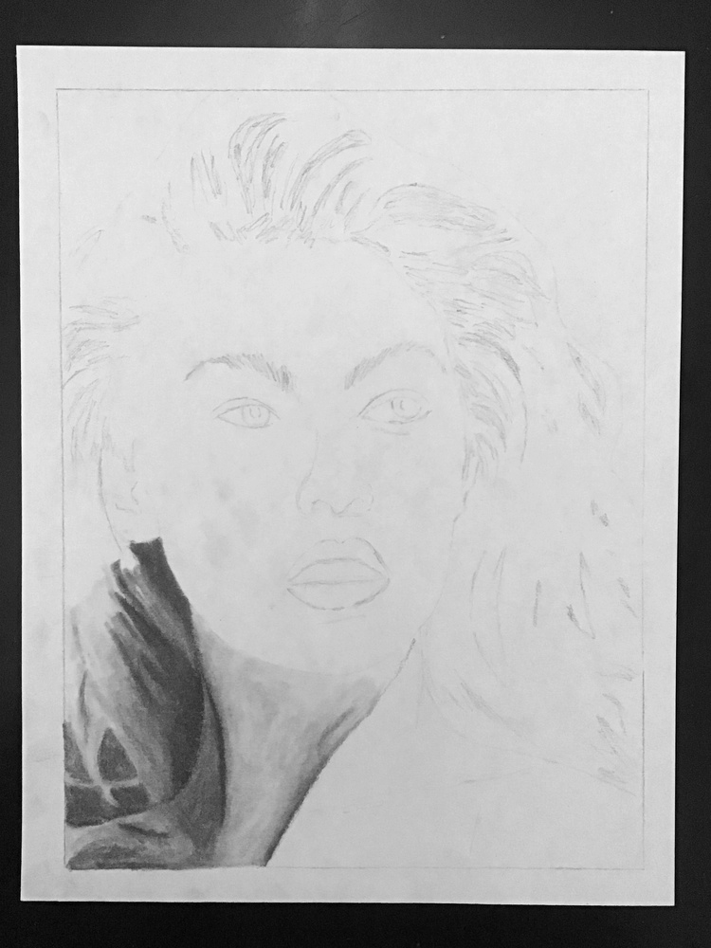
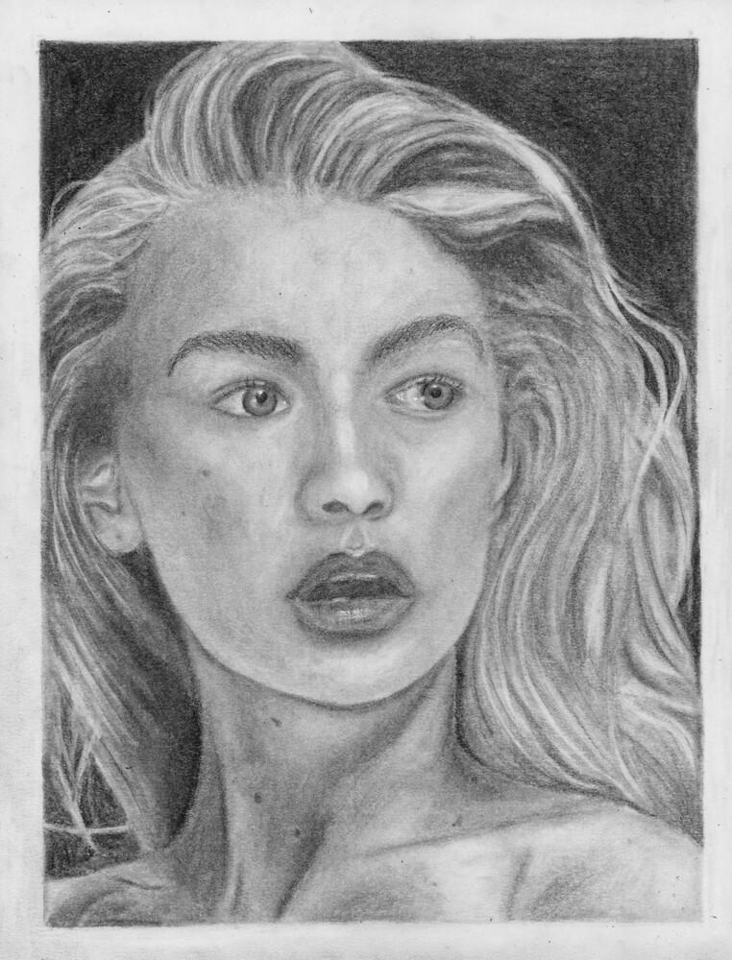
Self-portrait evaluation and building your skills step-by-step
XXXtranslationXXX
Proportion and detail: Shapes, sizes, and contour
XXXtranslationXXX
Shading technique: Deep black colours, smoothness, and blending
XXXtranslationXXX
Composition: Complete, full, finished, and balanced
XXXtranslationXXX
☐ 1. Learn the difference between looking and seeing.
XXXtranslationXXX
☐ 7. Practice drawing it all together.
XXXtranslationXXX
☐ 2. Improve your ability to see and draw details.
XXXtranslationXXX
☐ 8. Choose a reference photo with good lighting.
XXXtranslationXXX
☐ 12. Shade the lighter parts of the shirt and neck.
XXXtranslationXXX
☐ 3. Practice drawing angles and shading.
XXXtranslationXXX
☐ 9. Write one goal each day.
XXXtranslationXXX
☐ 13. Shade the dark parts of the hair, then the light.
XXXtranslationXXX
☐ 4. Practice blending to make things look 3D.
XXXtranslationXXX
☐ 10. Trace a light outline.
XXXtranslationXXX
☐ 14. Shade the dark parts of the face, then the lights.
XXXtranslationXXX
☐ 5. Practice drawing parts of the face.
XXXtranslationXXX
☐ 6. Improve how you draw hair textures.
XXXtranslationXXX
☐ 11. Shade the darkest parts of the neck and shirt.
XXXtranslationXXX
☐ 15. Shade to connect the parts, & find improvements.
XXXtranslationXXX

Slide 3
_____/10
Self-portrait goal setting
XXXtranslationXXX
At the end of each class, please take time to write your goal for the next class. Your artwork will be marked based on your detail, shading, and composition. Keep this in mind when choosing your goal.
XXXtranslationXXX
Be specific: What parts of your drawing are you focusing on? What drawing skills do you need most to do this?
XXXtranslationXXX
What should be improved and where: “Look for more detail in the sparkle of the eyes”
XXXtranslationXXX
What should be improved and where: “I need to blend the shading in the cheeks and chin”
XXXtranslationXXX
What can be added and where: “I need to add another fighter plane in the background”
XXXtranslationXXX
What you can do to catch up: “I need to ask my teacher if I can take my drawing home to work on it.”
XXXtranslationXXX

Slide 4
Vocabulary for the portrait project
XXXtranslationXXX
4B pencil -=30=- a graphite drawing tool that is darker and great for shading
XXXtranslationXXX
background -=30=- the part of an artwork that is far away
XXXtranslationXXX
blending -=30=- in drawing: mixing from light to dark greys; in painting: mixing from one colour to another
XXXtranslationXXX
brainstorming -=30=- coming up with a large number of ideas
XXXtranslationXXX
composition -=30=- the arrangement of things in an artwork
XXXtranslationXXX
contour drawing -=30=- drawing the edges and outlines
XXXtranslationXXX
contrast -=30=- the difference between the lights and darks
XXXtranslationXXX
creativity -=30=- ideas that are useful, unique, and insightful
XXXtranslationXXX
detail -=30=- small, important parts of a drawing
XXXtranslationXXX
foreground -=30=- the part of an artwork that is biggest and closest
XXXtranslationXXX
HB pencil -=30=- a graphite drawing tool that makes light lines
XXXtranslationXXX
layering -=30=- adding several small amounts of pencil or paint on top of each other
XXXtranslationXXX
modelling -=30=- making things 3D using blending
XXXtranslationXXX
reference photos -=30=- photographs you look at carefully so you can make a better artwork
XXXtranslationXXX
shading -=30=- drawing with white, black, and greys
XXXtranslationXXX
smoothness -=30=- drawing cleanly, with no bumps
XXXtranslationXXX
texture -=30=- drawing that looks the same as what it feels like
XXXtranslationXXX
web-mapping -=30=- linking together ideas like a spider web
XXXtranslationXXX
Notes:
Develop your idea first!
Divide your clay into four pieces: one for a base, two for coils, and one for everything else and for emergencies.
Make the bottom: a disc of clay that is 1-1.5 cm thick and 7-10 cm in diameter. Store any leftovers in your bag.
Stretch the coils by spreading your fingers while rolling.
Smooth your coils together using only one finger or one thumb.
Don’t pinch on either side because you will make your pot very dry and thin.
Add a foot by attaching a coil.
Scribe and then trim the lip.
Coat your pot with white slip. Let it dry and add coats until there are no streaks.
首先发展您的想法！
将您的粘土分为四个：一个用于底座，两个用于线圈，另一个用于其他所有物品和紧急情况。
使底部：粘土圆盘厚1-1.5厘米，直径为7-10厘米。将所有剩菜存放在您的包中。
滚动时通过手指张开手指来拉伸线圈。
仅使用一根手指或一只拇指一起将线圈平滑在一起。
不要在两边捏，因为您会使锅非常干燥。
通过连接线圈加入一只脚。
抄写员，然后修剪嘴唇。
用白色滑涂锅。让它干燥并加入外套，直到没有条纹为止。

Slide 5
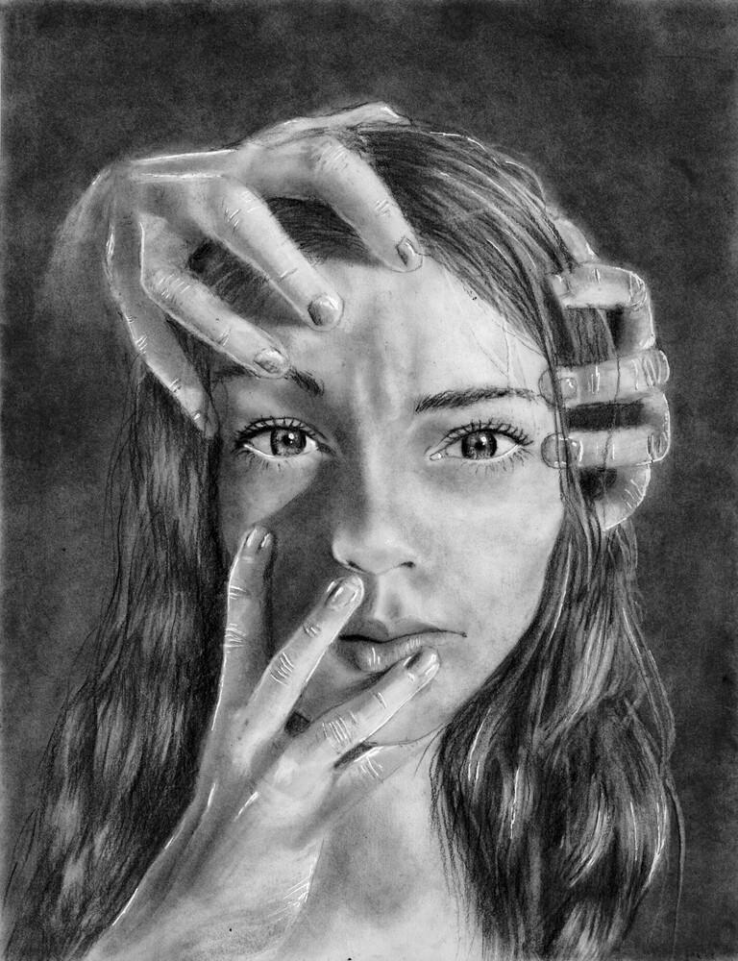
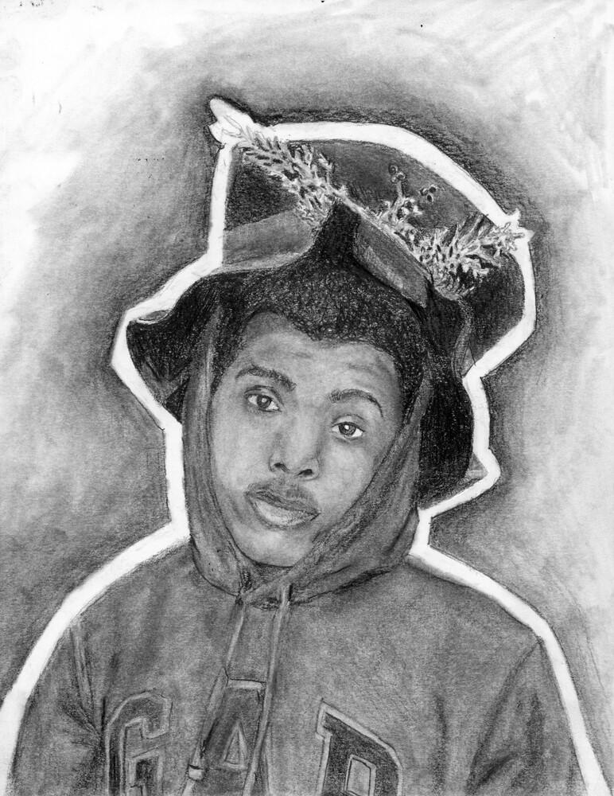
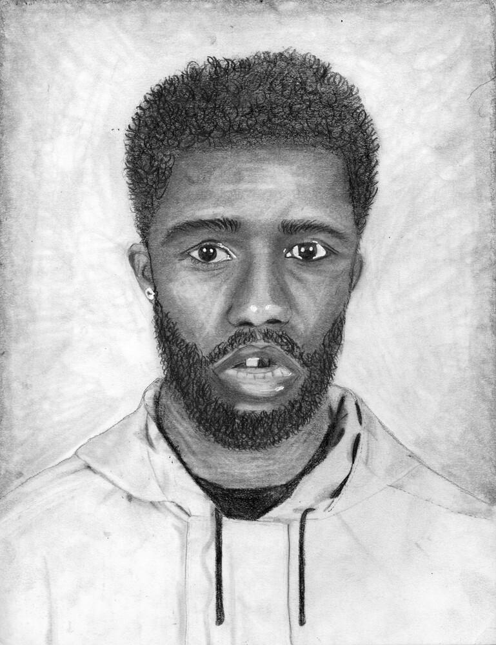
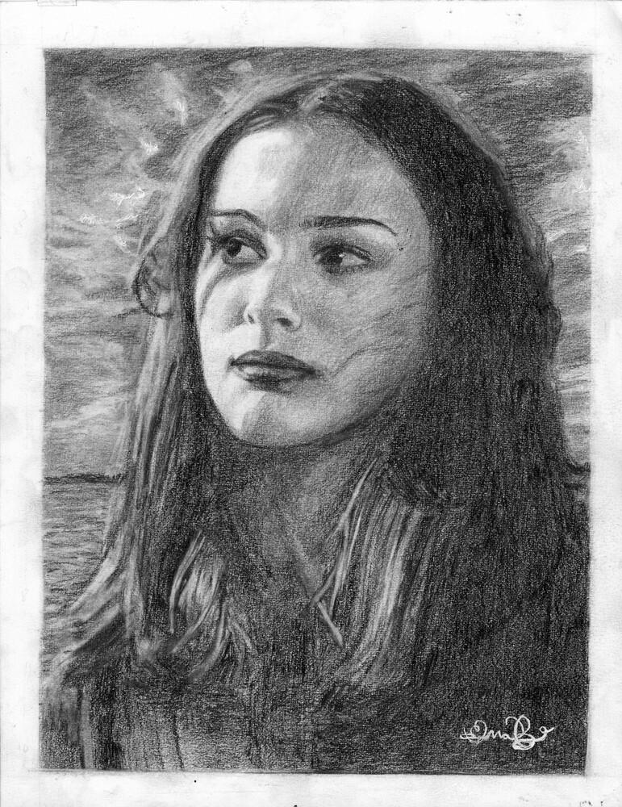
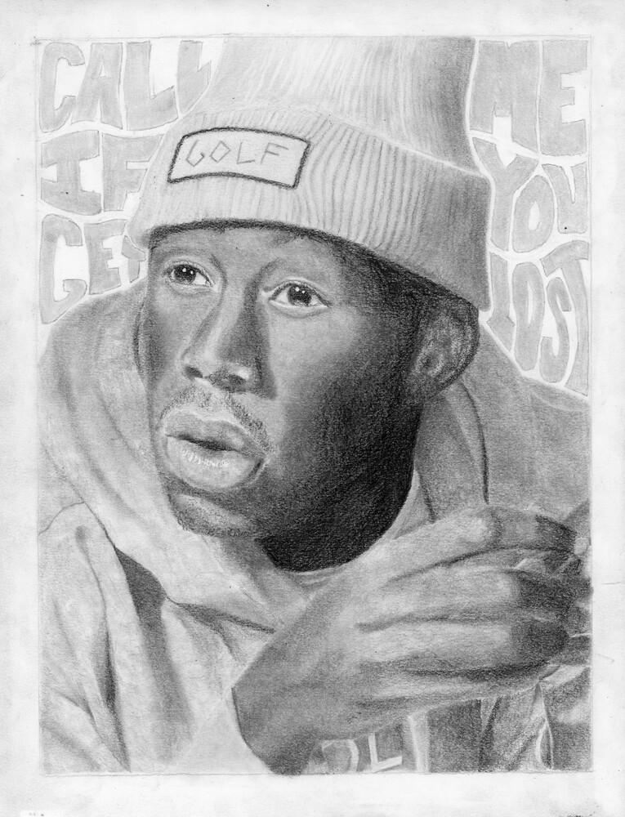
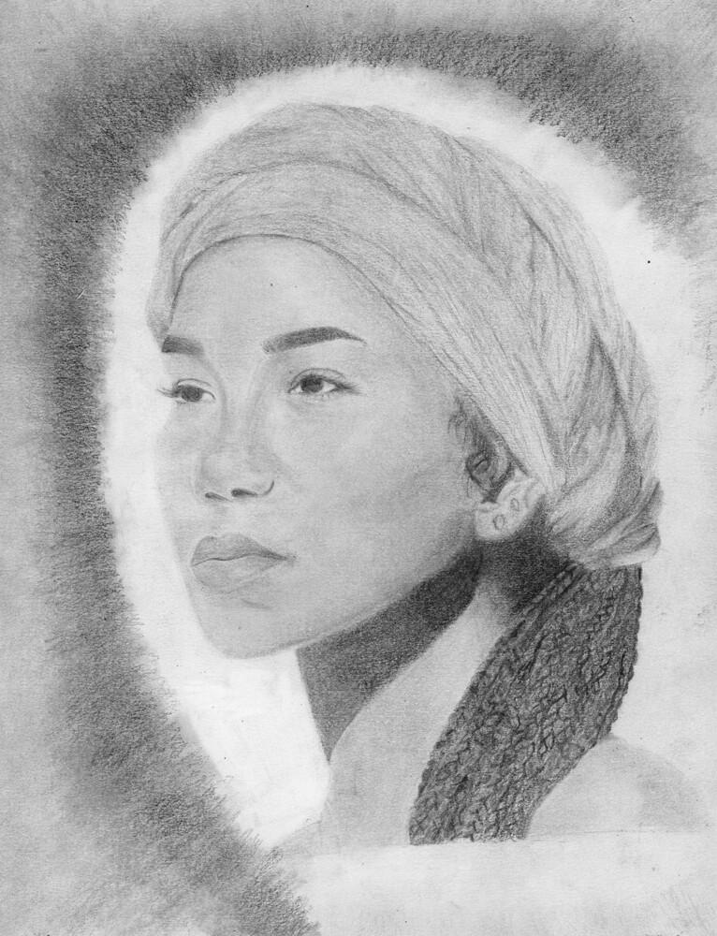
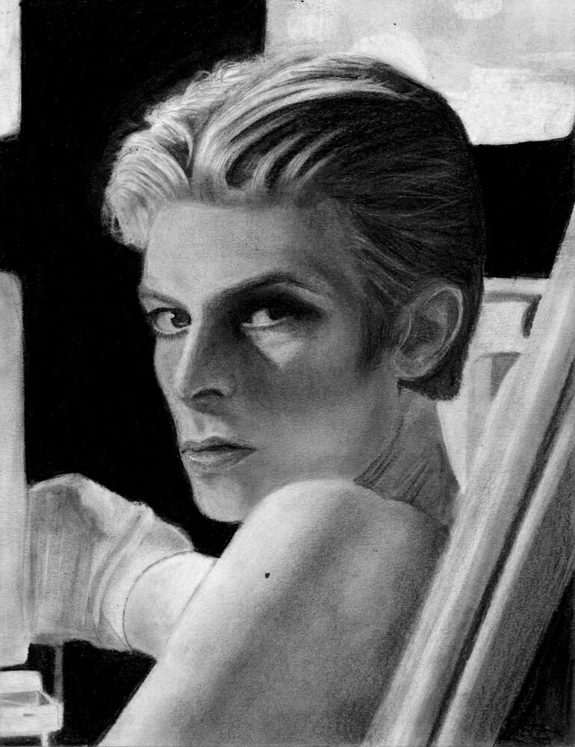












Morgan Marks, Spring 2024
Gabriel Correia, Spring 2024
Raquel Khoury, Spring 2024
Ella Brimacombe, Spring 2024
Quinn Ryall, Fall 2024
Lara Calder, Spring 2024
Taliyah Walter, Fall 2024
Scarlett Reynolds, Spring 2024
Nora Sutherland, Spring 2024
Zachary Dufour, Fall 2024
Anita Izadi, Spring 2024
Lena Epstein, Spring 2024
Sarthak Gade, Spring 2024
William McLeod, Fall 2024
Shreena Sen, Fall 2024
Sasha Kolokolnikov, Spring 2024
Darnell Upshaw, Spring 2024
Kate Morgan-MacFadyen, 2024
Catherine Fraser, Spring 2024

Slide 6


















Xintang Wang, Fall 2023
Chloe Taylor, Fall 2023
Arik Arik, Fall 2023
Mariah Wentzell, Fall 2023
Matt Inkpen, Fall 2023
Carter Jecks, Fall 2023
Ahsan Amir, Fall 2023
Olivia Woodill, Fall 2023
Mya Honey, Fall 2023
Gaelle Bousquet, Fall 2023
Lily Campbell, Fall 2023
Mya Rimmer, Fall 2023
Emmy Bickerton, Fall 2023
Sophia Rogers, Fall 2023
Opemipo Ajetomobi, Spring 2024
Joshua Richardson, Spring 2024

Slide 7


Now draw your hand with as much detail as possible, but you are allowed to look at it this time.
XXXtranslationXXX
Skill builder - Draw a Hand
XXXtranslationXXX
Much of drawing is learning how to forget your mental picture of something and instead focus on the visual properties (such as line, shading, proportion, and texture) that you see.
XXXtranslationXXX
Draw a hand with as much detail as possible, but without looking at your hand, or anyone else’s.
XXXtranslationXXX

Slide 8





Redraw this picture as carefully as you can, focusing on detail. Capture the bumps, angles, curves, and lengths. Shapes & sizes will be distorted.
XXXtranslationXXX
Drawing basics: Learning how to see — Part One
XXXtranslationXXX
Pablo Picasso, Portrait of Igor Stravinsky, 1920
XXXtranslationXXX

Slide 9

Redraw this picture as carefully as you can, focusing on angles and shading. Capture the shapes and aim for clean, smooth shading.
XXXtranslationXXX
Drawing basics: Angles and basic shading
XXXtranslationXXX
Kazimir Malevich, Woodcutter, 1912-13
XXXtranslationXXX

Slide 10


Drawing basics: A shading reference for pears
XXXtranslationXXX
Realistic shading comes from careful observation. Choose one of these pears and draw it. Notice how the shadow changes from light to dark as it goes across the surface of the pear. Shade in the stem, the details of the surface of the skin, the darkness of the background. Go slowly so that you can observe the visual characteristics carefully.
XXXtranslationXXX
Choose one picture to do well. Remember that it is better to go slowly and observe carefully that speed through and finish quickly.
XXXtranslationXXX
Take your time: you are training your brain to observe like an artist.
XXXtranslationXXX

Slide 11


Drawing basics: A shading reference for pears
XXXtranslationXXX

Slide 12












Skill builder: Parts of the face
XXXtranslationXXX
Draw each part of the face in the empty rectangles.
XXXtranslationXXX
Start by outlining the major parts very lightly. Use a light grid, if you like.
XXXtranslationXXX

Slide 13












When your drawing is finished, there should not be any outlines. Remember that photographs capture the world by recording patterns and shapes of light and dark.
XXXtranslationXXX
Build up the darkness in several layers in order to make things black enough. Use your blender at the very end. If possible, do all of the smoothing carefully with your pencil.
XXXtranslationXXX

Slide 14









Mica Paul, Spring 2023
Max Seale, Spring 2023
Sophia Falle, Spring 2023
Reid Gillis, Spring 2023
Johnylah James, Spring 2023
Elle Langley, Spring 2023
Lexy Berry, Spring 2023
Alexa Maillet, Spring 2023
Andel Brown, Fall 2023

Slide 15

Portraiture — Shading hair textures

Slide 16


Portraiture — Shading and proportion

Slide 17


Slide 18





Skill builder
Half portraits
Put it all together. Choose one portrait to complete. You can finish by copying, or flipping it like a mirror.
Or, find a picture of someone else and draw half of their face instead.
Heny Patel, Spring 2019

Slide 19







Slide 20
Creativity — Brainstorming practice I
XXXtranslationXXX
Creativity can be learned. The biggest mistake for beginners is trying to keep all of your ideas in your head. You are going to practise listing a large number of ideas in order to improve your creative skills.
XXXtranslationXXX
You will improve your ability to generate a large number of ideas.
XXXtranslationXXX
You will improve your ability to suspend judgement until after your idea is recorded. Most people stop good ideas while they are still in their mind.
XXXtranslationXXX
You will improve your ability to intentionally seek out unusual or specific ideas related to a topic.
XXXtranslationXXX
Please choose a topic: -=30=- ☐ sports ☐ movies ☐ music ☐ games ☐ fashion ☐ animals
XXXtranslationXXX
When you are finished, please count the number of ideas you generated: _________________
XXXtranslationXXX

Slide 21
Creativity — Brainstorming practice II
XXXtranslationXXX
Creativity can be learned. The biggest mistake for beginners is trying to keep all of your ideas in your head. You are going to practise listing a large number of ideas in order to improve your creative skills.
XXXtranslationXXX
You will improve your ability to generate a large number of ideas.
XXXtranslationXXX
You will improve your ability to suspend judgement until after your idea is recorded. (Most people stop good ideas while they are still in their mind.)
XXXtranslationXXX
You will improve your ability to intentionally seek out unusual or specific ideas related to a topic.
XXXtranslationXXX
Please choose a topic: -=30=- ☐ things that make you different than others ☐ things that irritate you ☐ things you love
XXXtranslationXXX
When you are finished, please count the number of ideas you generated: _________________
XXXtranslationXXX
After counting, please draw a circle or rectangle around your most interesting ideas.
XXXtranslationXXX

Slide 22
Developing an idea for your portrait
XXXtranslationXXX
Who could your portrait be about?
XXXtranslationXXX
You will like your portrait more if you have many ideas to choose from.
XXXtranslationXXX

Slide 23
Use whatever creativity techniques help you come up with the best and most ideas.
XXXtranslationXXX
You can list ideas, or link them, or make an idea cloud, a web-map, tell a story, or sketch.
XXXtranslationXXX
What could they be doing?
XXXtranslationXXX
Where could they be?
XXXtranslationXXX
Next class, please circle your two best people, two best actions, and two best backgrounds.
XXXtranslationXXX

Slide 24









Lena Ubani, Fall 2022
Erin Kells, Fall 2022
Tyler Lafitte, Fall 2022
Siyun Lee, Fall 2022
Parker Smith, Fall 2022
Cecily Harnum, Fall 2022
Leelah Makhoul, Fall 2022
Drew Gooding, Fall 2022
Kokheb Tesfatsion, Spring 2023

Slide 25














The portrait project
all time hall of fame
Bishir Green,
Fall 2021
Lauren Sparkes,
Spring 2021
Maddy Whidden,
Fall 2020
Anna Wuensch,
Spring 2020
Deborah Belachew,
Spring 2022.
Lola Jiao,
Spring 2018
Kaya Panthier,
Spring 2019
Sean Wong,
Fall 2018
Hayden Coyle,
Fall 2017
Sean Yu,
Fall 2019
Sabrina Ashik,
Spring 2017
Calum MacKinnon,
Fall 2016
Zoe Bartel,
Spring 2016
Danny Liu,
Fall 2015
Ji Yoon Park,
Spring 2014

Slide 26
Self-portrait: Mid-project feedback to students
XXXtranslationXXX
This project will be evaluated according to three general criteria. In order to help you do your best, here is some feedback with suggestions about how to improve your drawing. I have only chosen what I think are the most important pieces of advice for you. If these suggestions are unclear, please ask me or a friend to give you more help.
XXXtranslationXXX
Proportion and detail
XXXtranslationXXX
Proportion is the name of the skill where you accurately portray shapes and sizes.
XXXtranslationXXX
☐ Observe closely. Keep looking at your photograph. Try to forget what you are looking at, and focus on the component lines and shapes.
XXXtranslationXXX
☐ Look for missing details. Look for small things that you may have overlooked: small bits of your hair, wrinkles in your clothing, small differences in the background, and so on.
XXXtranslationXXX
☐ Start drawing the other half of your face. If you develop one side of the face too fully, it will be hard to match it up with the other side.
XXXtranslationXXX
☐ Measure carefully. Use a grid, rulers, or slips of paper to guide where you should place things.
XXXtranslationXXX
☐ Observe the shapes of your shadows. The shapes of the parts of the face are good, but the shapes of the shadows are off. Take a closer look at the shapes and sizes of the light and dark areas.
XXXtranslationXXX
☐ Consider changes in texture. Hair needs a different kind of drawing than cloth, skin, or fuzzy shadows. Try to capture the texture of the different things you are drawing.
XXXtranslationXXX
Shading
XXXtranslationXXX
Shading is using light and dark to draw. It is an easy way to make things look realistic and three dimensional.
XXXtranslationXXX
☐ Lighten your outlines. Outlines are essential to getting proportions correct, but they should disappear after you start shading.
XXXtranslationXXX
☐ Darken your darks. Doing so will increase the overall impact of your drawing, and will help it pop.
XXXtranslationXXX
☐ Add tone to your lights. Leaving areas white tends to leave the impression that your artwork is unfinished. Instead, look for light shades of grey you can add instead.
XXXtranslationXXX
Notes:
Develop your idea first!
Divide your clay into four pieces: one for a base, two for coils, and one for everything else and for emergencies.
Make the bottom: a disc of clay that is 1-1.5 cm thick and 7-10 cm in diameter. Store any leftovers in your bag.
Stretch the coils by spreading your fingers while rolling.
Smooth your coils together using only one finger or one thumb.
Don’t pinch on either side because you will make your pot very dry and thin.
Add a foot by attaching a coil.
Scribe and then trim the lip.
Coat your pot with white slip. Let it dry and add coats until there are no streaks.
首先发展您的想法！
将您的粘土分为四个：一个用于底座，两个用于线圈，另一个用于其他所有物品和紧急情况。
使底部：粘土圆盘厚1-1.5厘米，直径为7-10厘米。将所有剩菜存放在您的包中。
滚动时通过手指张开手指来拉伸线圈。
仅使用一根手指或一只拇指一起将线圈平滑在一起。
不要在两边捏，因为您会使锅非常干燥。
通过连接线圈加入一只脚。
抄写员，然后修剪嘴唇。
用白色滑涂锅。让它干燥并加入外套，直到没有条纹为止。

Slide 27
☐ Work on smoothness. Build up your greys by stacking layers of alternating line directions, use lines with overlapping lines (no white gaps), or use a blending stump.
XXXtranslationXXX
☐ Work on blending. Your shadows are sometimes going abruptly from light to dark, with few or no middle grays. Add grays to the middle areas until you end up with smooth blends instead of sudden jumps.
XXXtranslationXXX
☐ Start shading your background. Once you shade in your background, it changes the balance of greys and forces you to reshade the rest of your portrait. If you start shading your background early it will save you time and frustration.
XXXtranslationXXX
☐ Look carefully at the different grays in your hair. You can get basic hair texture by creating lines that flow along the length. However, it works even better when you replicate the pattern of light and dark of the different strands. It takes more time, but the impact is many times stronger.
XXXtranslationXXX
☐ Watch for sharp vs. fuzzy edges. Sometimes blending goes quickly from light to dark, and sometimes it stretches out over a long distance. Reobserve your photo to see where you should do which one.
XXXtranslationXXX
Composition
XXXtranslationXXX
Composition is the overall arrangement and completeness of your artwork.
XXXtranslationXXX
☐ You have the option of leaving out the background if you wish.
XXXtranslationXXX
☐ Add a background. A background puts a person or object in a particular place, real or imaginary. Compared to drawings without backgrounds, your artwork may look simple and incomplete.
XXXtranslationXXX
☐ Start shading your background. You have some lines in there, but it lacks substance in comparison to the rest of your drawing.
XXXtranslationXXX
☐ Start drawing the other half of your face. If you develop one side of the face too fully, it will be hard to match it up with the other side.
XXXtranslationXXX
☐ You seem to be behind. Please consider working on your project at lunch or before or after school. Or, try to pick up your pace or use your time more effectively during class. If you have enough done, you can ask if you can take it home to work on it. Remember that if too much of your work is done outside school I cannot accept it.
XXXtranslationXXX
Notes:
Develop your idea first!
Divide your clay into four pieces: one for a base, two for coils, and one for everything else and for emergencies.
Make the bottom: a disc of clay that is 1-1.5 cm thick and 7-10 cm in diameter. Store any leftovers in your bag.
Stretch the coils by spreading your fingers while rolling.
Smooth your coils together using only one finger or one thumb.
Don’t pinch on either side because you will make your pot very dry and thin.
Add a foot by attaching a coil.
Scribe and then trim the lip.
Coat your pot with white slip. Let it dry and add coats until there are no streaks.
首先发展您的想法！
将您的粘土分为四个：一个用于底座，两个用于线圈，另一个用于其他所有物品和紧急情况。
使底部：粘土圆盘厚1-1.5厘米，直径为7-10厘米。将所有剩菜存放在您的包中。
滚动时通过手指张开手指来拉伸线圈。
仅使用一根手指或一只拇指一起将线圈平滑在一起。
不要在两边捏，因为您会使锅非常干燥。
通过连接线圈加入一只脚。
抄写员，然后修剪嘴唇。
用白色滑涂锅。让它干燥并加入外套，直到没有条纹为止。

Slide 28

















Usman Arifov, Fall 2024
Sydney DeMings, Fall 2024
Brady Nielsen, Fall 2024
Leeluu Derouchie, Fall 2024
Yvette Lai, Fall 2024
Liam Carney, Fall 2024
Greta McLaren, Fall 2024
Emma Savoie, Fall 2024
Kauthar Green, Fall 2024
Eli Webber, Fall 2024
Lydia Marryatt, Fall 2024
Ronan Surette, Fall 2024
Sofia Tucker, Fall 2024
Neve McGrath, Fall 2024
Akiyrah Stevenson, Fall 2024
Ruby Hilewitz, Spring 2025
Isaiah Taranza, Spring 2025

