Slide 1
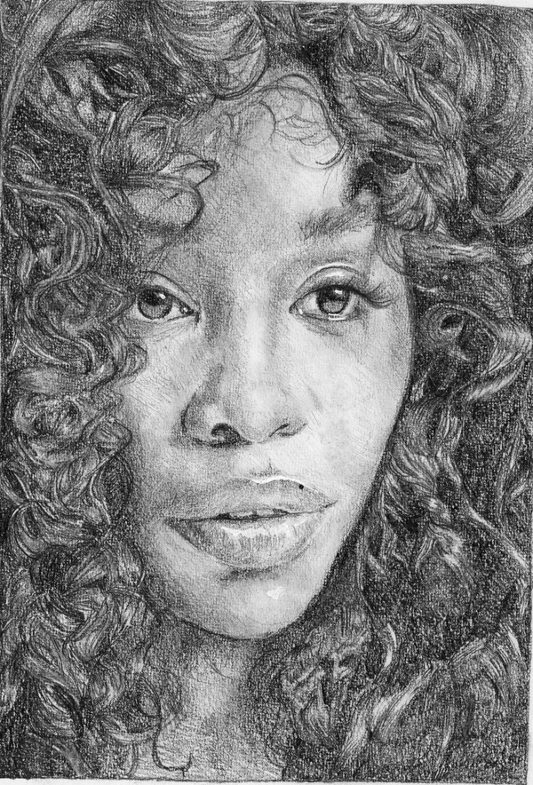
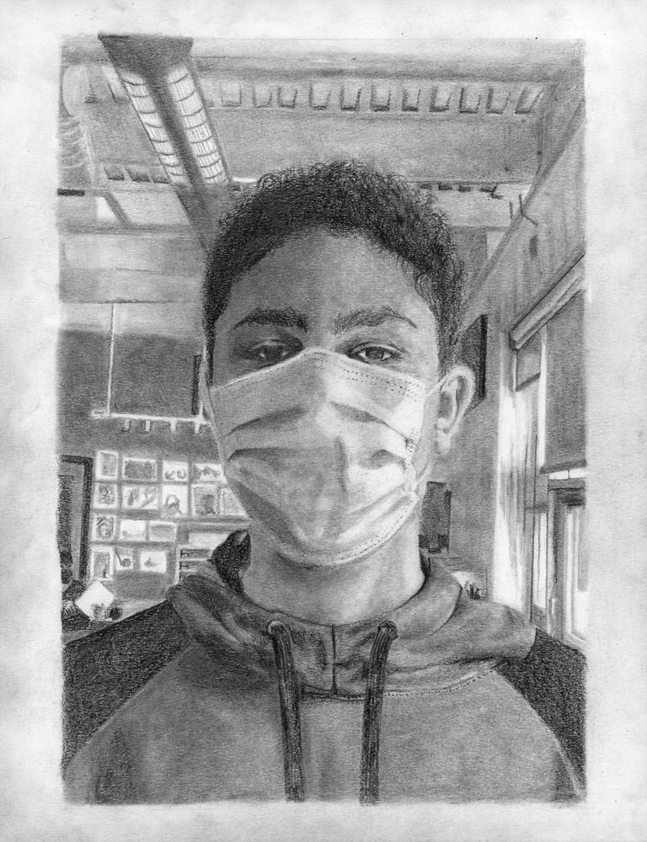
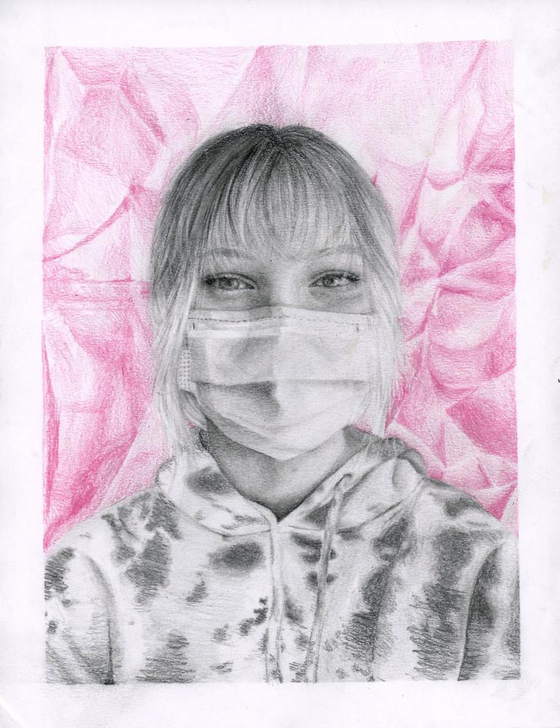
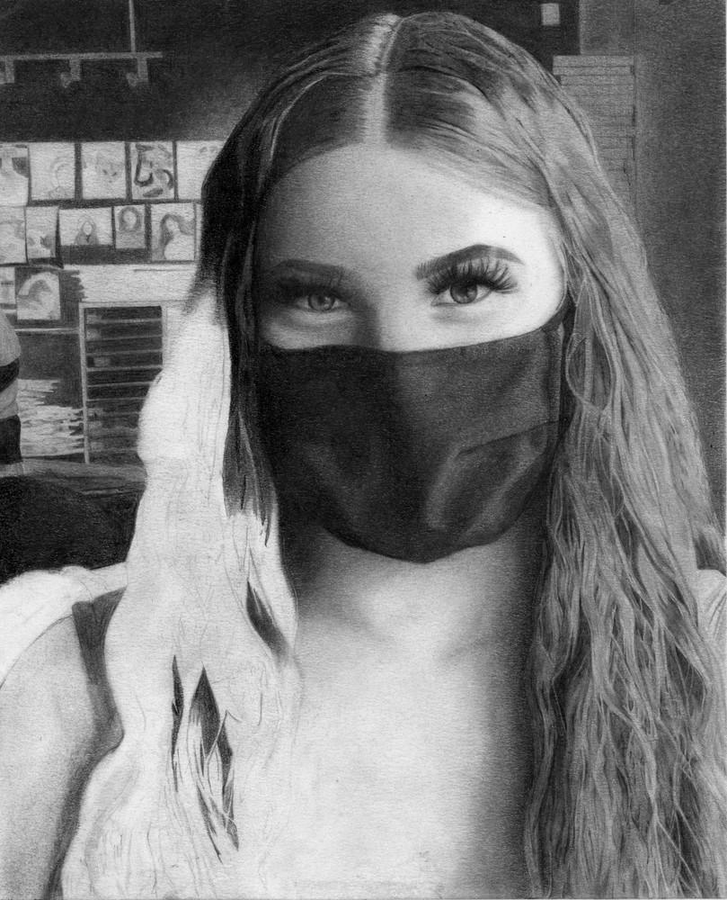
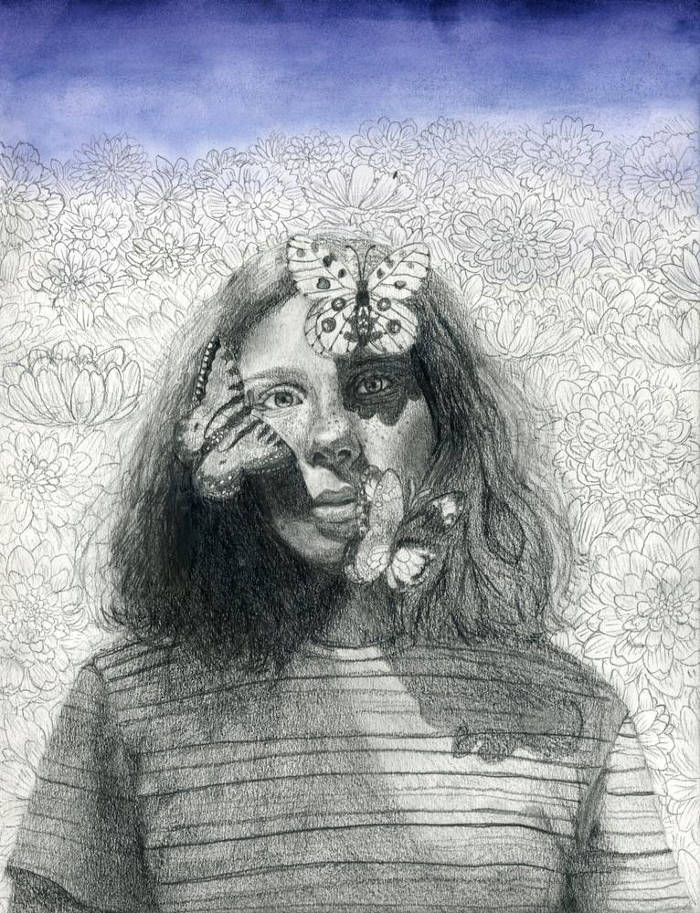
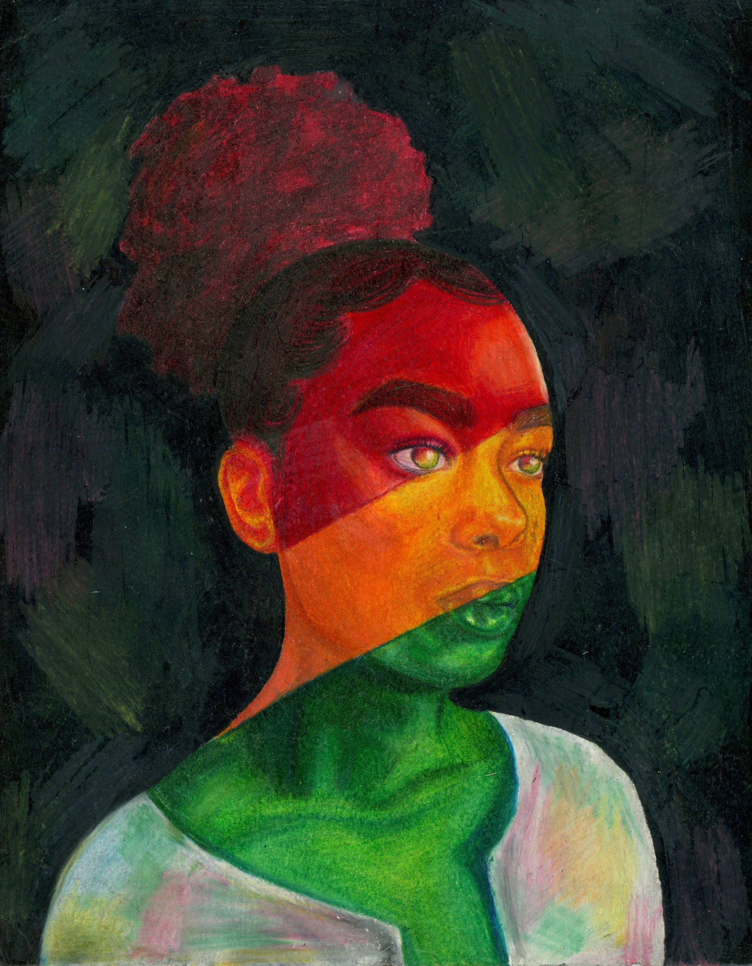
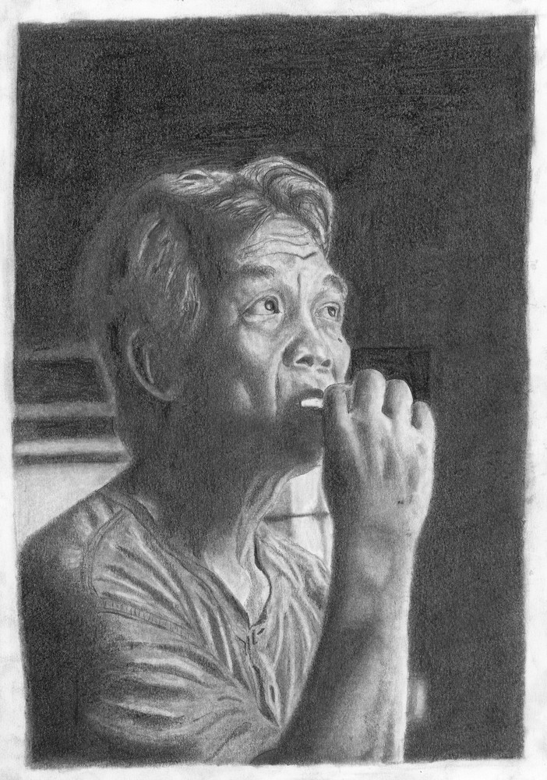
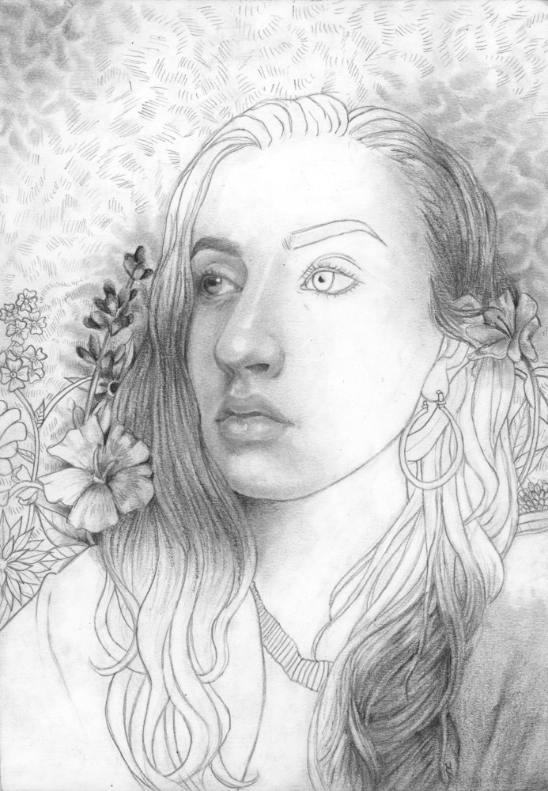
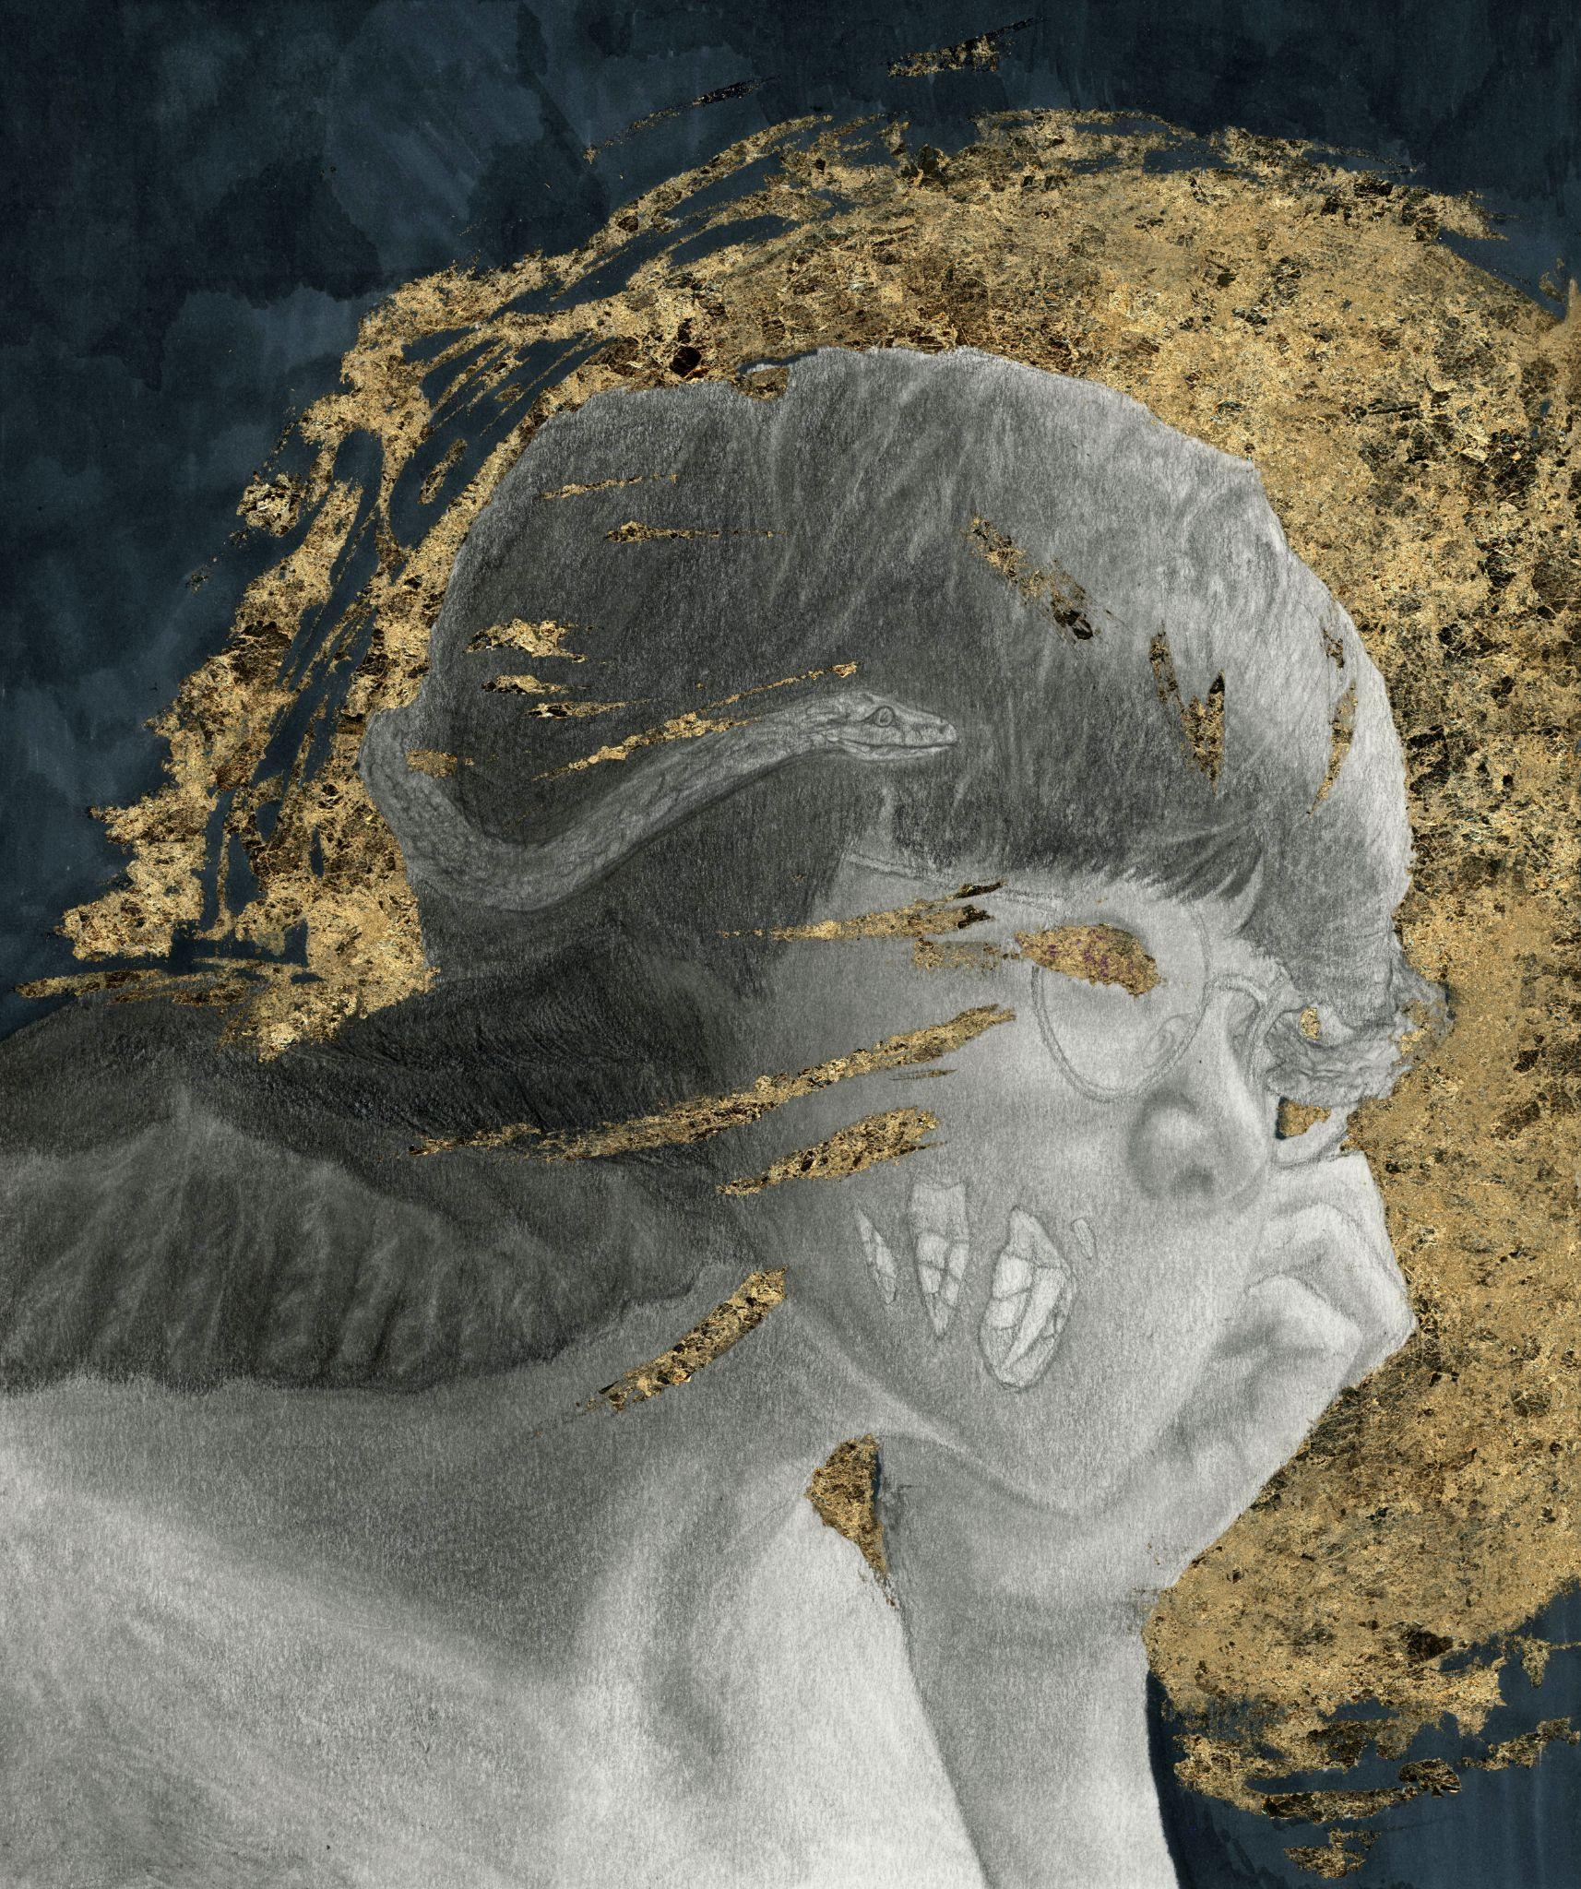
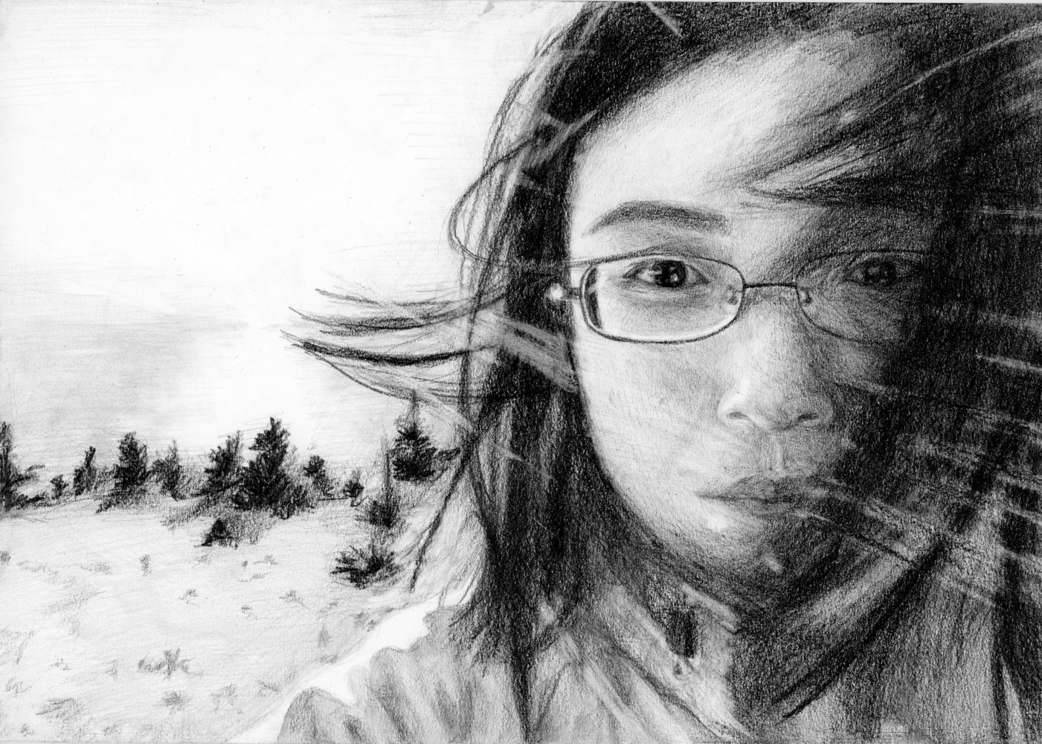
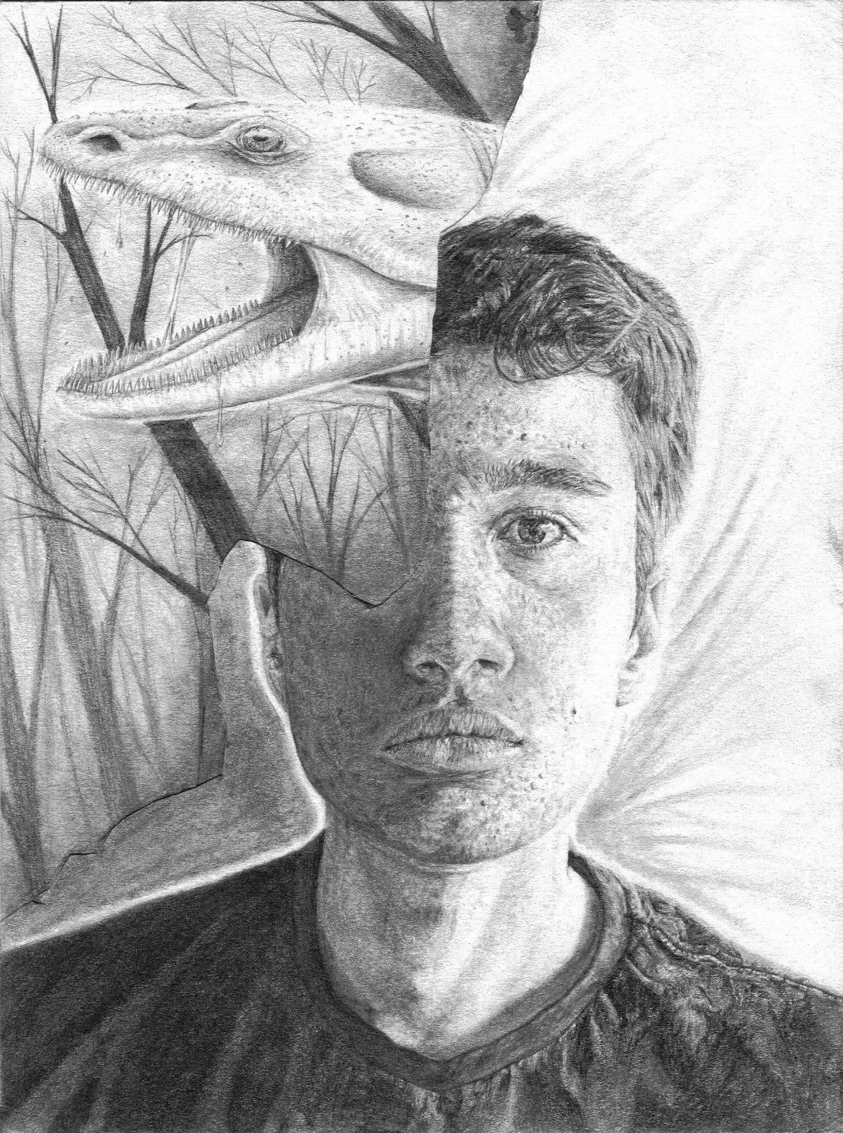
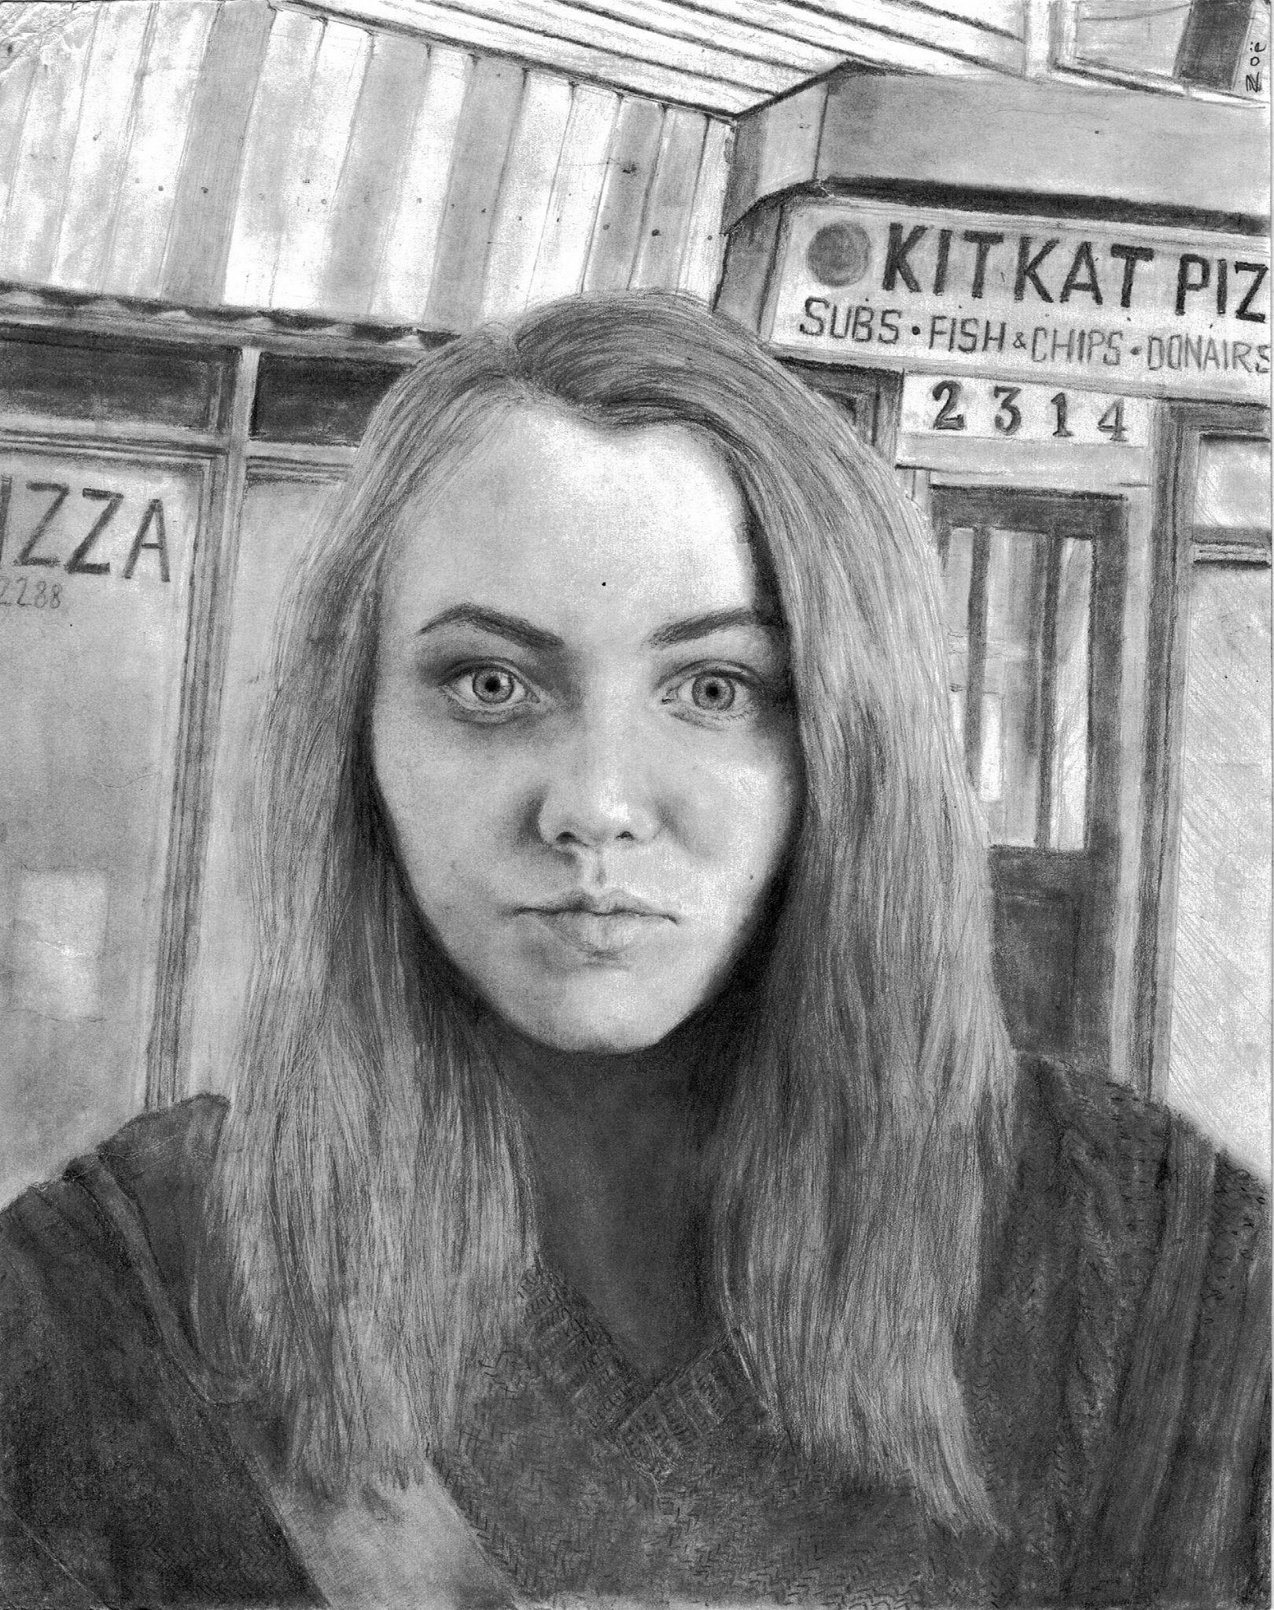
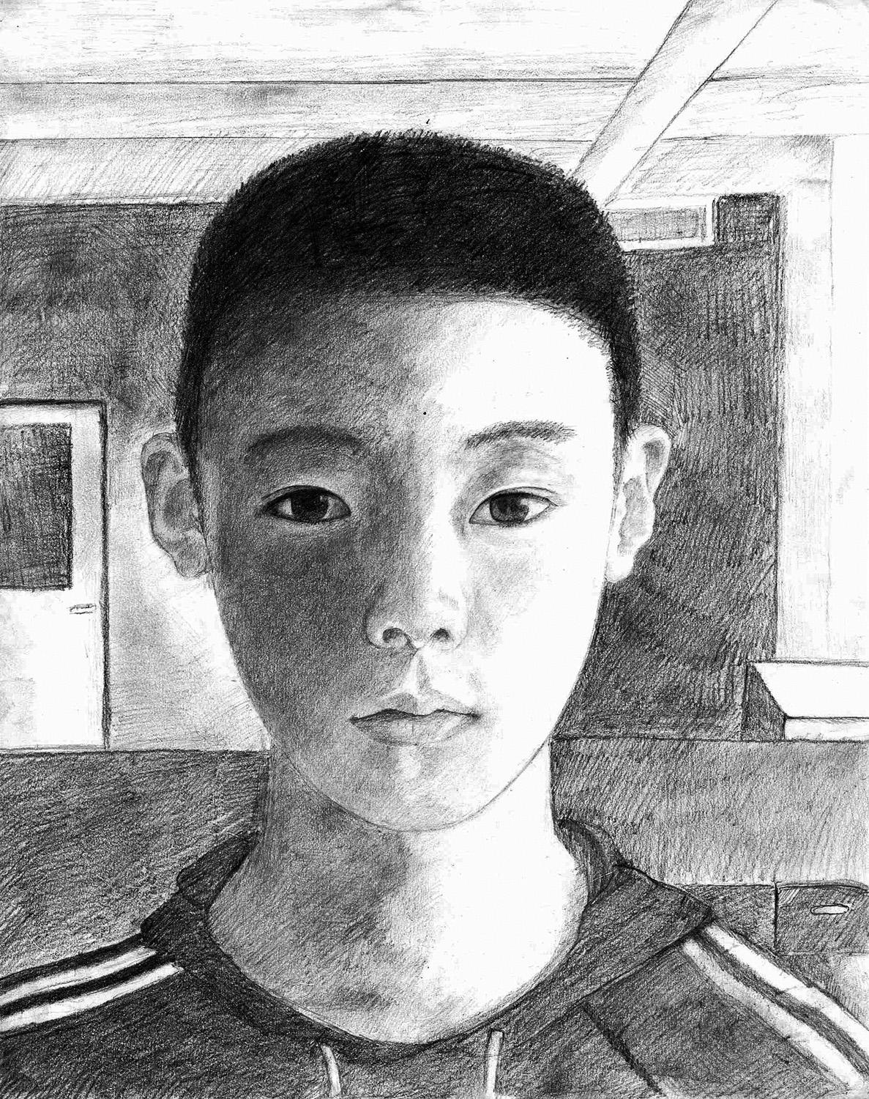
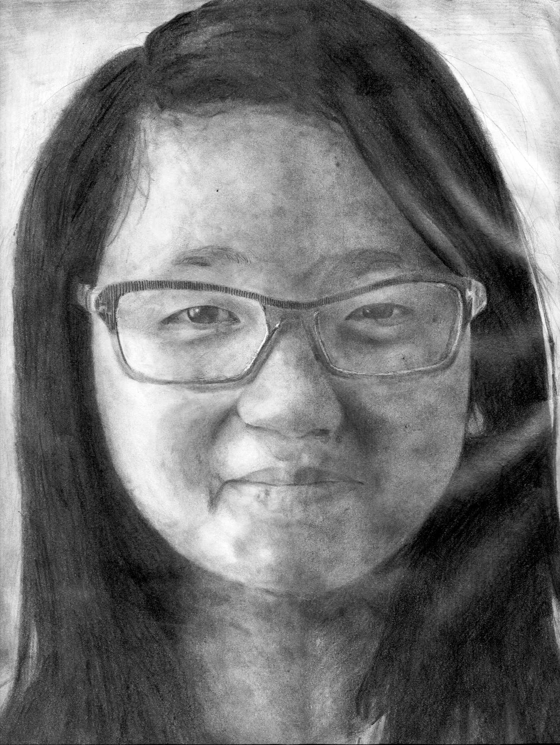
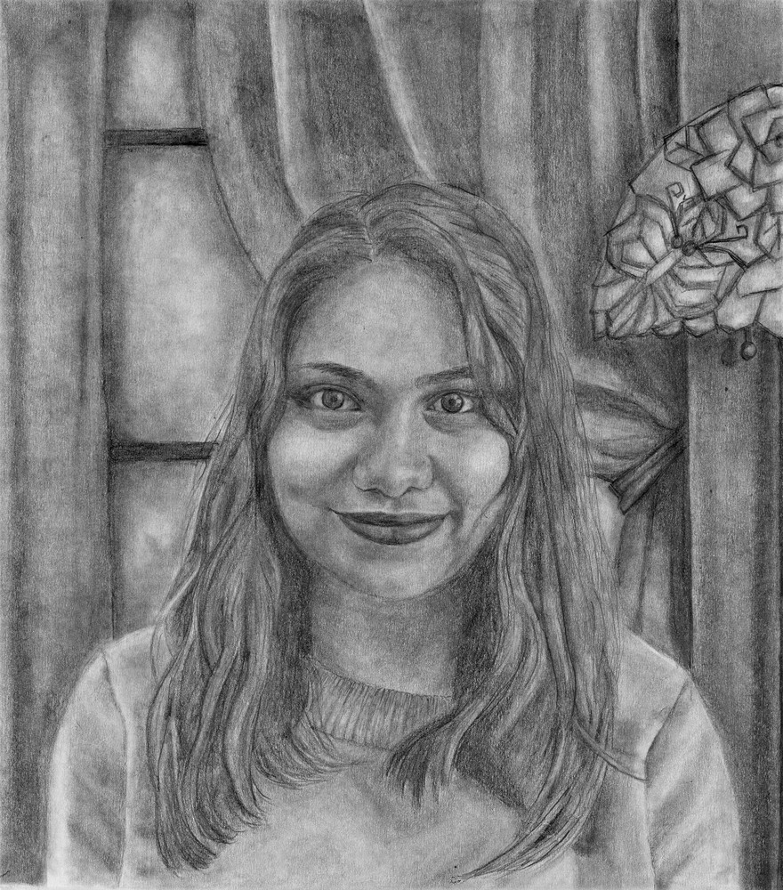
The portrait project
all time hall of fame
Bishir Green,
Fall 2021
Lauren Sparkes,
Spring 2021
Maddy Whidden,
Fall 2020
Anna Wuensch,
Spring 2020
Deborah Belachew,
Spring 2022.
Lola Jiao,
Spring 2018
Kaya Panthier,
Spring 2019
Sean Wong,
Fall 2018
Hayden Coyle,
Fall 2017
Sean Yu,
Fall 2019
Sabrina Ashik,
Spring 2017
Calum MacKinnon,
Fall 2016
Zoe Bartel,
Spring 2016
Danny Liu,
Fall 2015
Ji Yoon Park,
Spring 2014

